Slide 1
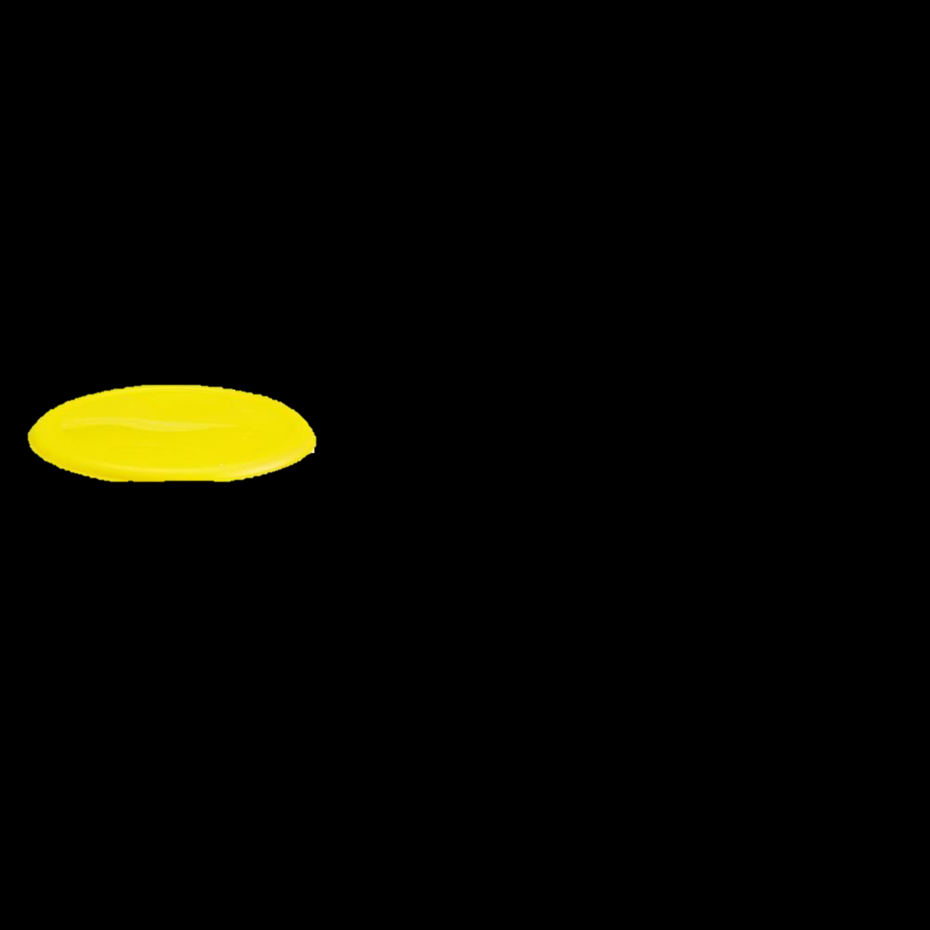
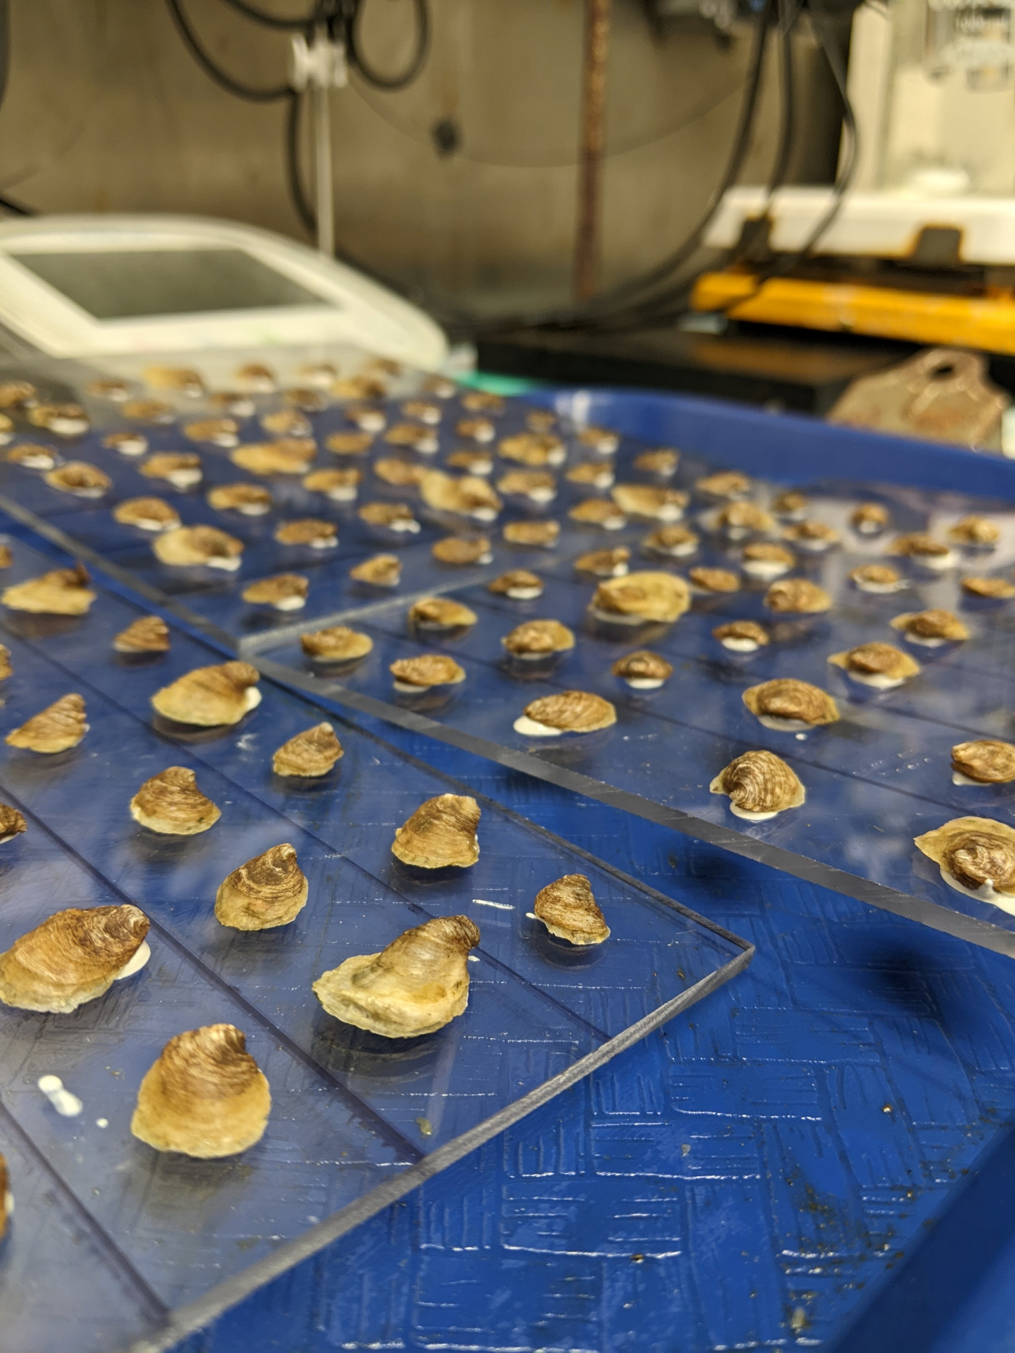
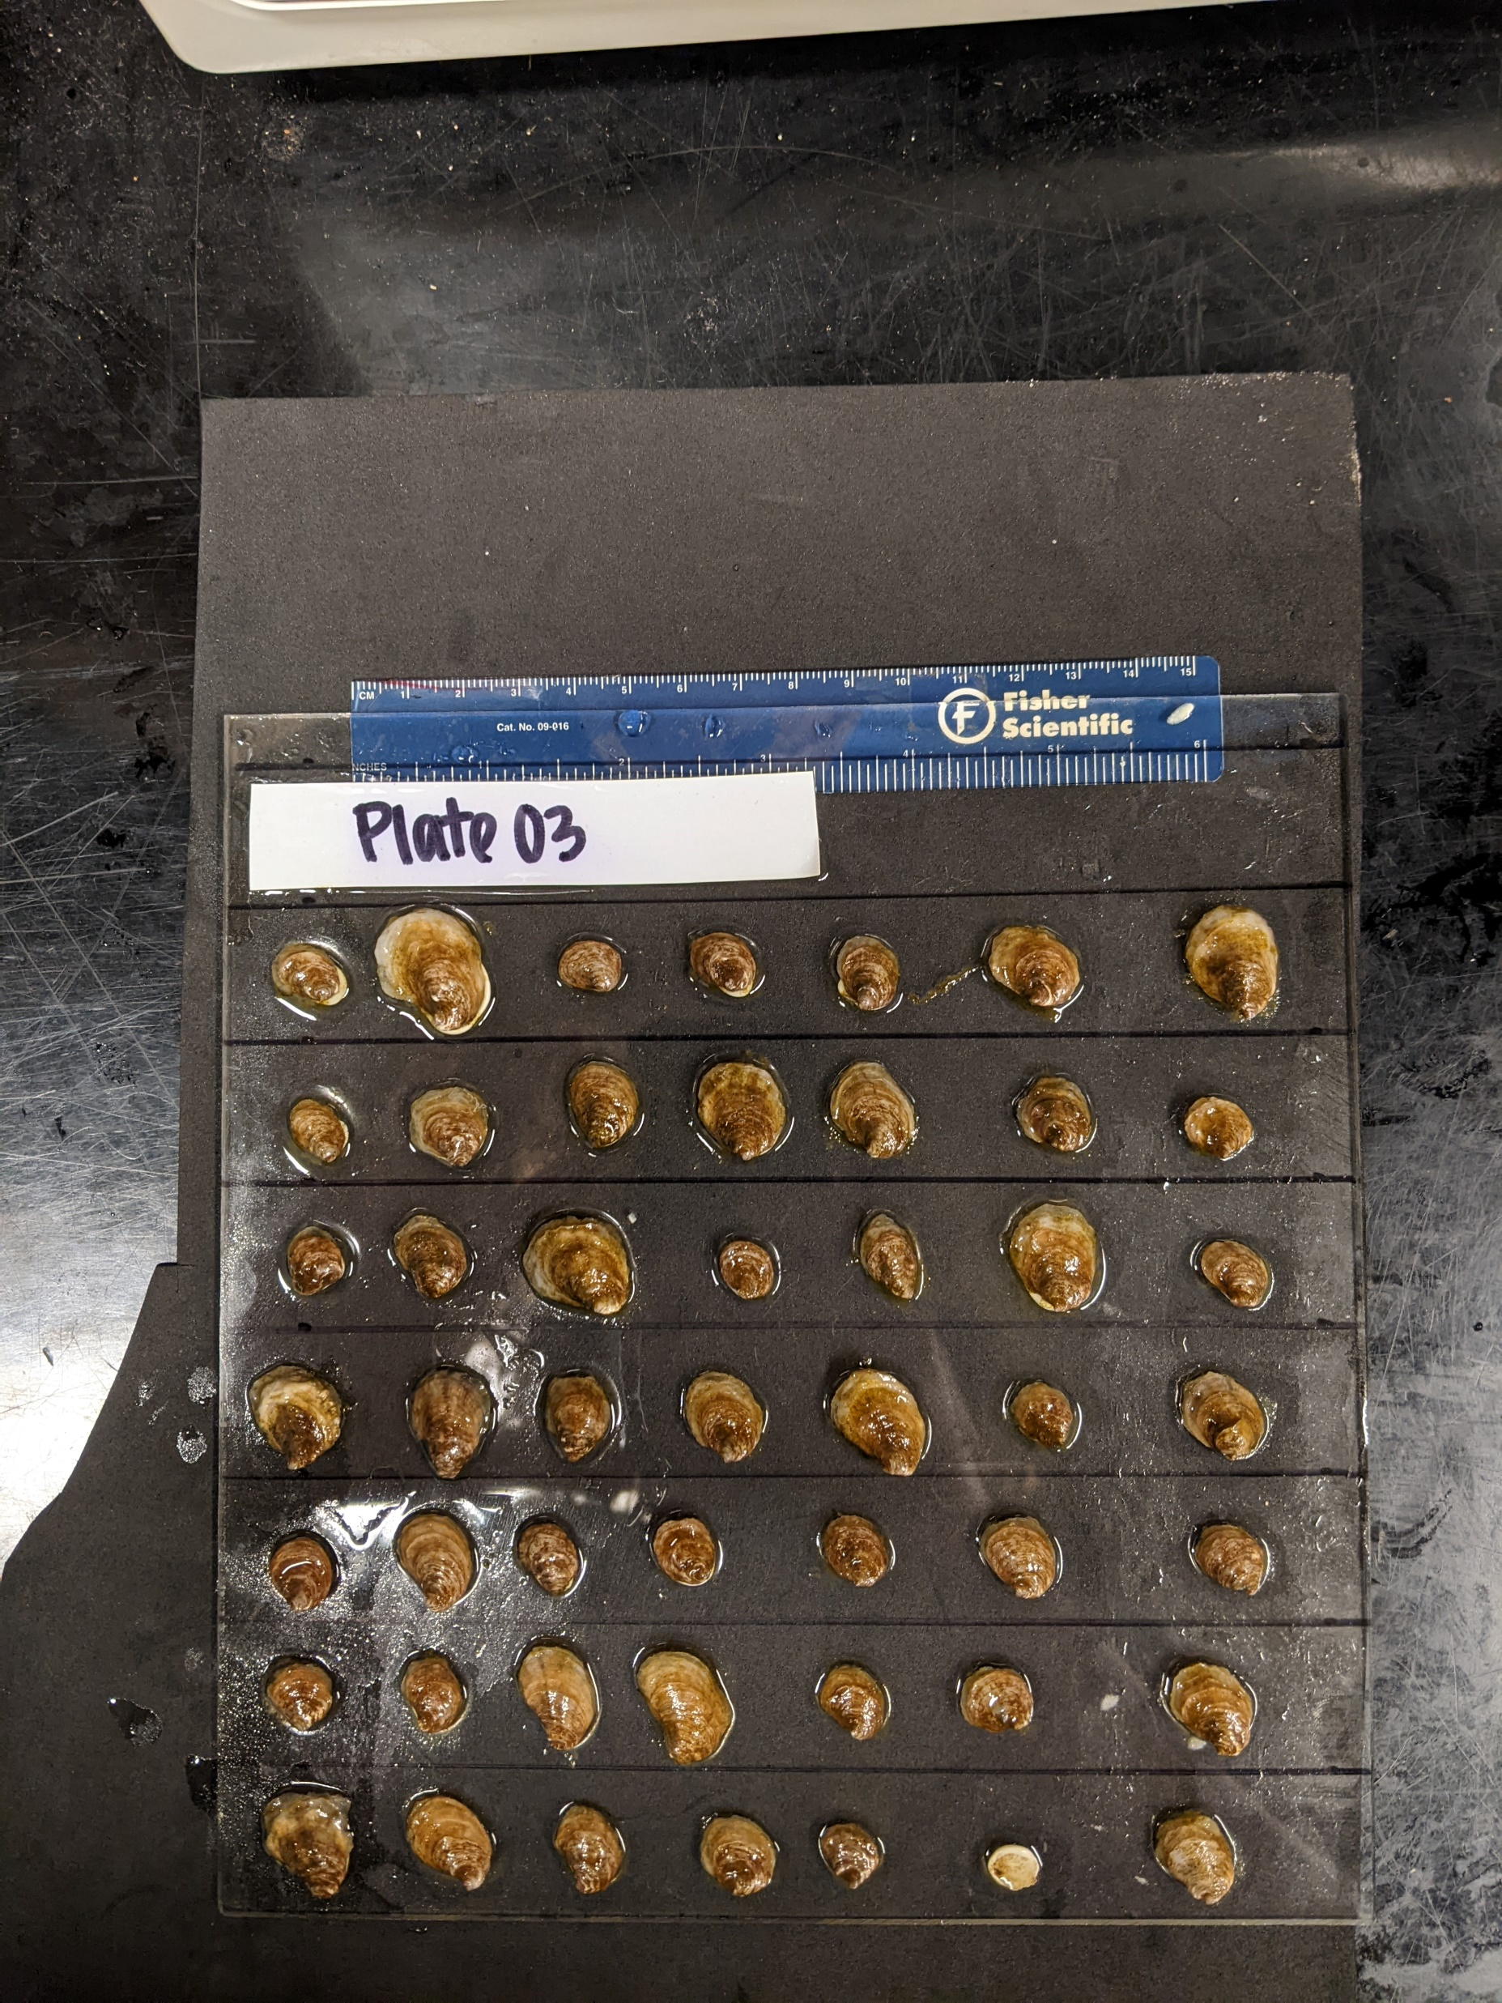
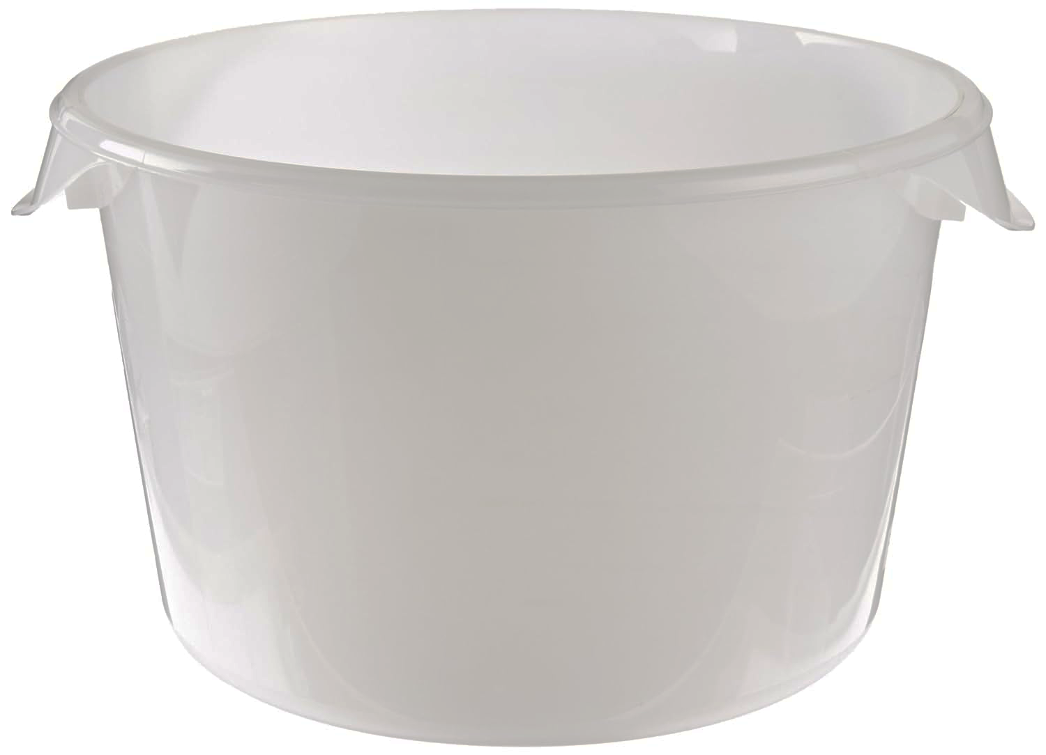
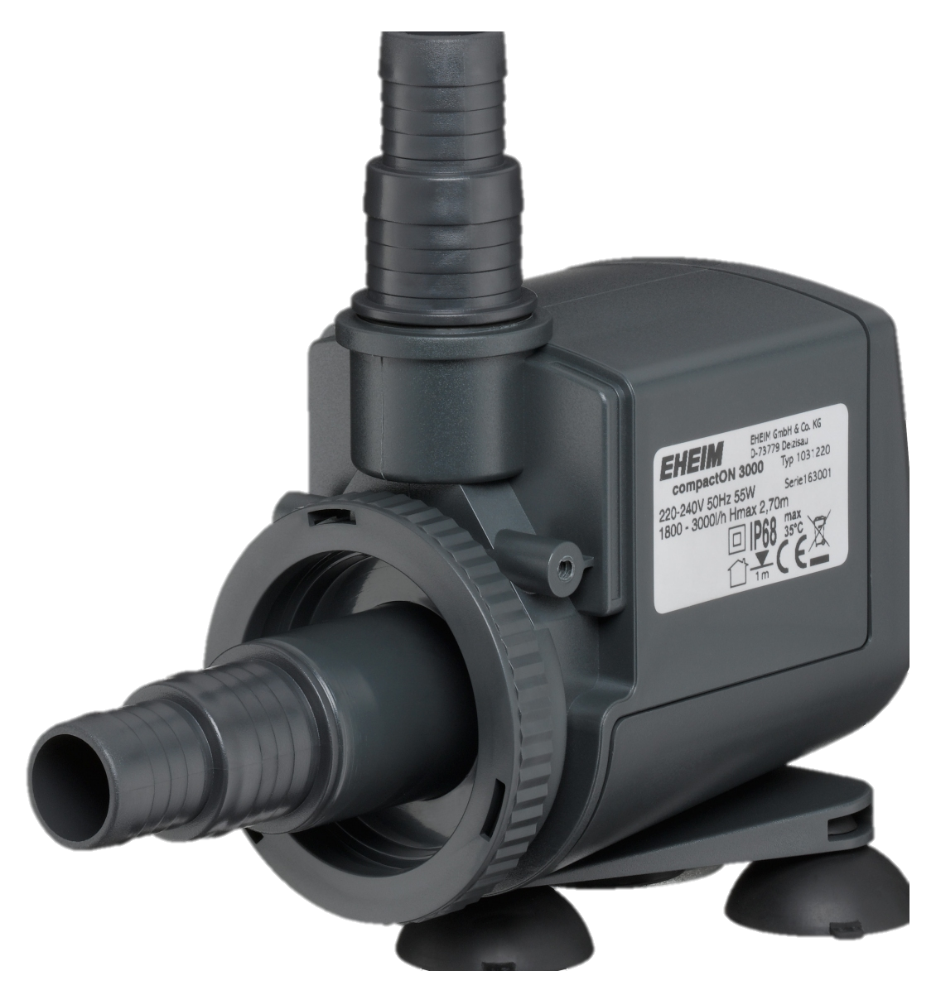
Bin layout
S treatment
n = 49 oysters per plate, 1 plate per bin
Seawater refreshed 2x per week
ambient (S = 34)
low (S = 27)
TA condition
Target conditions
reduce
955
µmol kg⁻¹
n = 2 bins
near ambient
1955
µmol kg⁻¹
n = 2 bins
elevate
2900
µmol kg⁻¹
n = 2 bins
‘rain’
790
µmol kg⁻¹
n = 2 bins
‘low TA river’
1485
µmol kg⁻¹
n = 2 bins
‘high TA river’
2200
µmol kg⁻¹
n = 2 bins

Slide 2
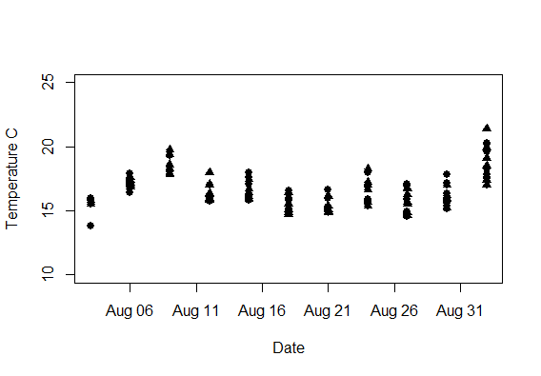
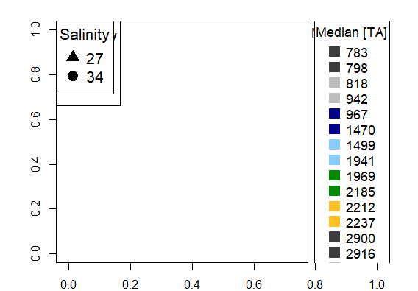
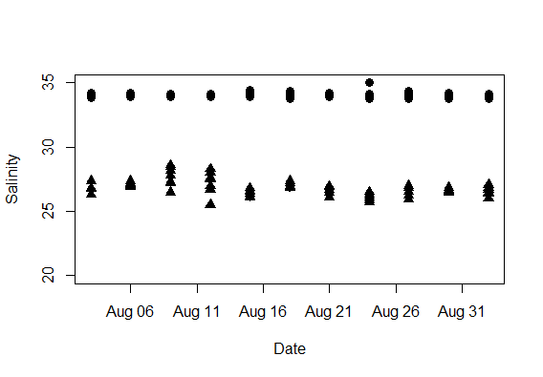
Salinity & temp
Temperature C
Salinity
Date (2022)
Fig 1. X

Slide 3
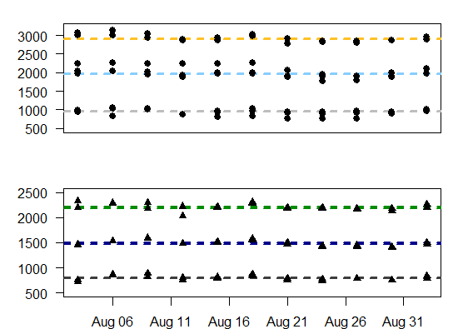
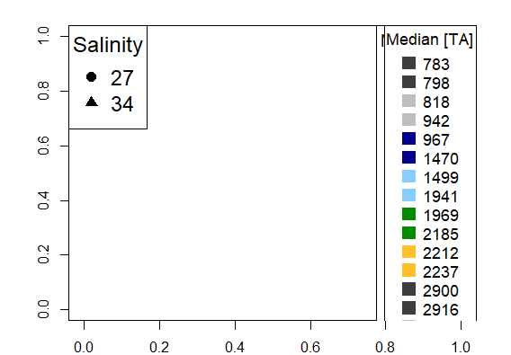
Carbonate chemistry
Total alkalinity (umol kg -1)
Date (2022)
Fig 1. X

Slide 4
Effect of S (comparing bc Om are similar (TA ish) sal diff
Fig 1. X

Slide 5
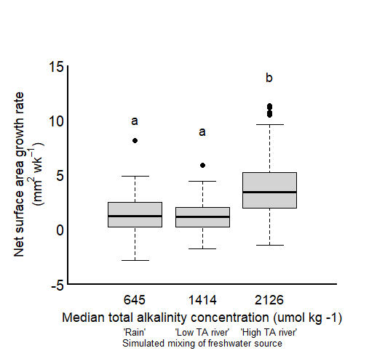
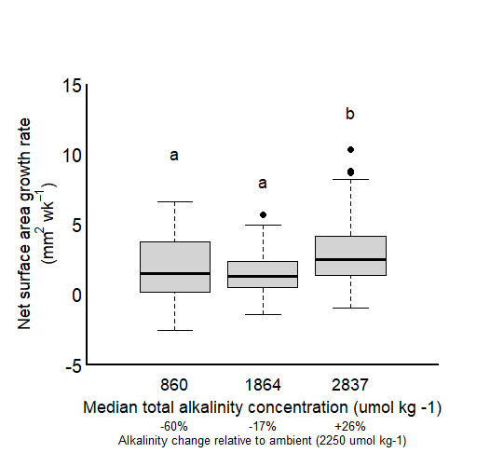
Effect of TA in low salinity
#Shell wt both went up about 0.2 g per unit increase in SA mm2...it was a little higher but still similar to control. This means that treatments did not change how the oysters were growing (lateral vs thickness vs upward dome).
The low TA treatment had med Om less than one and the middle at Om just over 1.
The low TA treatment had med Om less than one; the other were over 1
The variability in net surface area growth rate within alkalinity treatments was lowest in the treatments closest to ambient conditions, and equally larger in both high and low TA conditions, in ambient S.
Fig 1. X
In contrast to survival, pH (pHT = 7.212 ± 0.004) had a negative effect on length-based shell growth rates of juvenile C. virginica (p < 0.05; 3-way ANOVA; Table 1, Fig. 5B; Table S16). While shell growth rates among normocapnic pH treatments ranged from 0.005 to 0.02 mm d−1, rates were signif icantly re du ced under low pH conditions, with indi viduals at 31°C under low pH and individuals at 24°C under low pH and low DO displaying no shell based growth during the entire 4 wk experiment (Fig. 5B).
Gut weight was higher than in controls pre and post in all treatments (sufficiently fed), but did not differ based on TA or S treatment (suggests no change to X ability)

Slide 6
Effect of TA
Fig 1. X

Slide 7
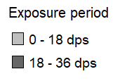
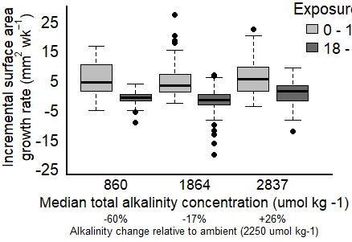
Incremental growth amb S
The low TA treatment had med Om less than one; the other were over 1
Fig 1. X

Slide 8
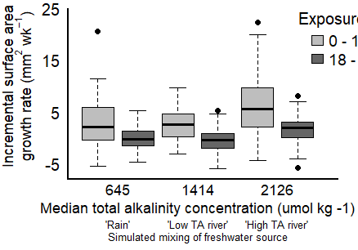
Incremental growth low S
The low TA treatment had med Om less than one and the middle at Om just over 1.
Fig 1. X

Slide 9
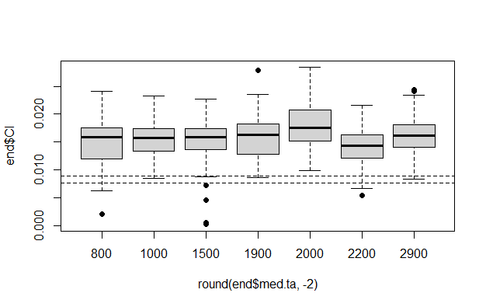
T2 and T3 CI = ave pre; the rest are stat lower
Looked at figures for gut wt and shell growth and it looks like the gut wt is really what contributed to changing CI…
the only treatment that showed an increase in CI relative to the rest, was the nearest to ambient conditions. In all other treatments there was no discernable impact of TA or S on CI at the end.

Slide 10
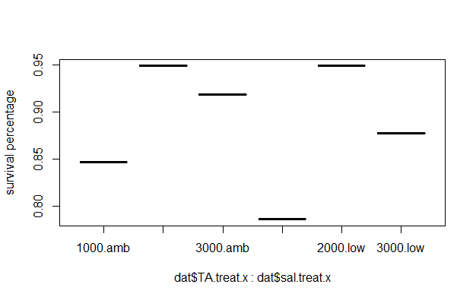
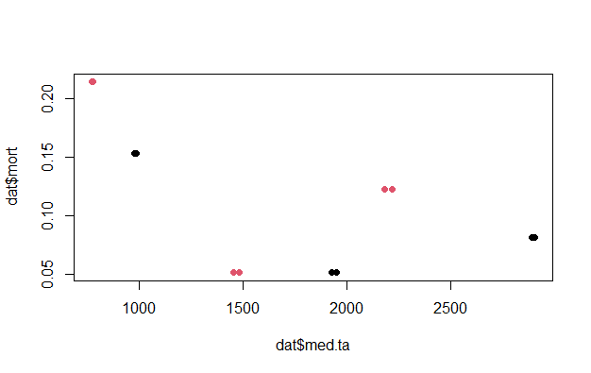
Survival only dropped below 86% in the low TA category for both S
Low TA was the only factor (ie ph is X) that reduced survival below 85%; between these two treatments, low salinity expressed slightly lower survival. The rest of the Ta and S treatments exhibited high survival.
We did not see an interaction between TA and S on survival; it was dominated by TA (1000umol change corresponded to a 0.045 survival decline from model)

Slide 11
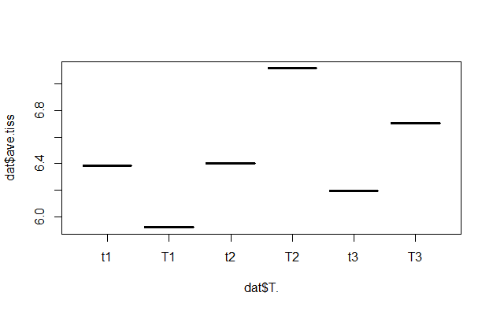
Ave tissue wt at the end… lowest in the low TA, then lowest at low S, then similarly high in high S and med/high TA
Regarding tissue weights of the juvenile oysters, individuals exposed to 31°C were sig - nificantly lighter than individuals grown at 24°C (p < 0.0001; 3-way ANOVA; Fig. 5C; Table S17).
Gut wt/ave tiss was not strongly influenced by TA or S changes
All treatments were greater than what we saw in the control individuals

Slide 12
Comparison paper vs Our paper
this study, hypoxia, acidification, and elevated temperatures all affected each species, with low pH and low DO conditions most consistently having a negative impact on survival, shell growth, tissue weights, and/or respiration rates.
Firstly, of the 3 stressors investigated, low pH treatments significantly worsened the performance of juvenile bivalves less frequently (66% of experiments) than low DO (90% of experiments) but more frequently than elevated temperature (50% of experiments)
while C. virgi -nica never experienced heightened mortality under low pH.
Juvenile C. virginica and M. edulis were highly vulnerable to thermal stress, experiencing significant reductions in survival, shell growth, and/or tissue weight at elevated temperatures
Blah blah

Slide 13
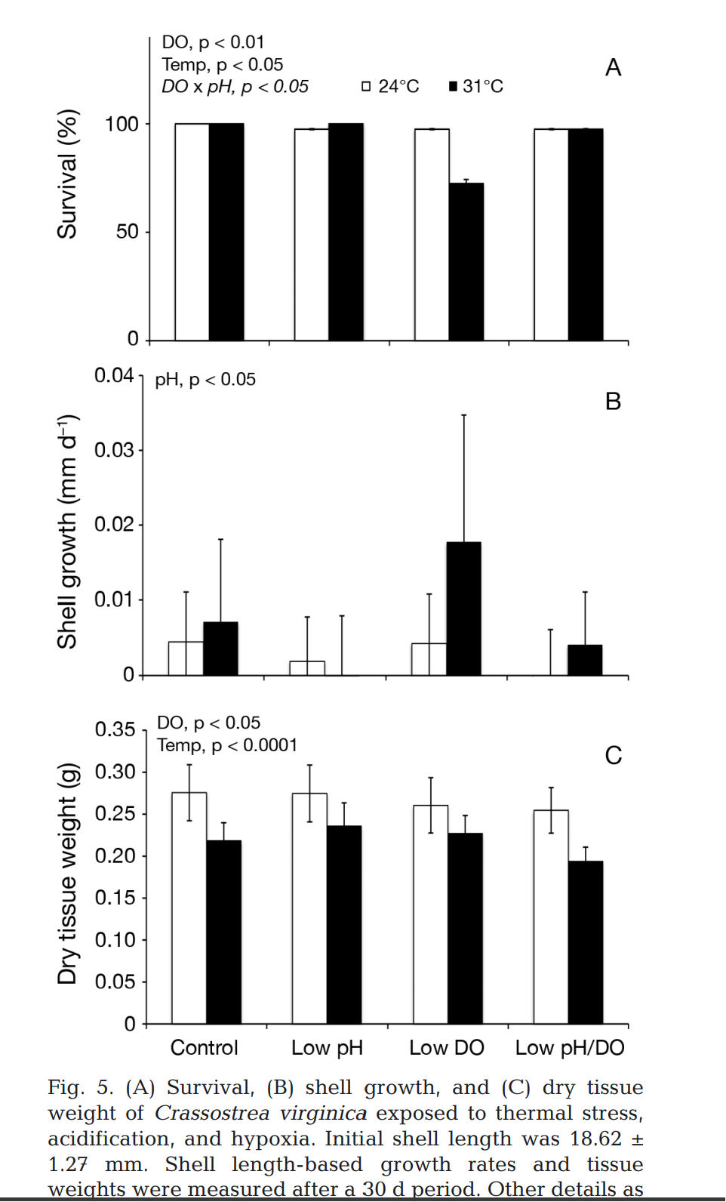
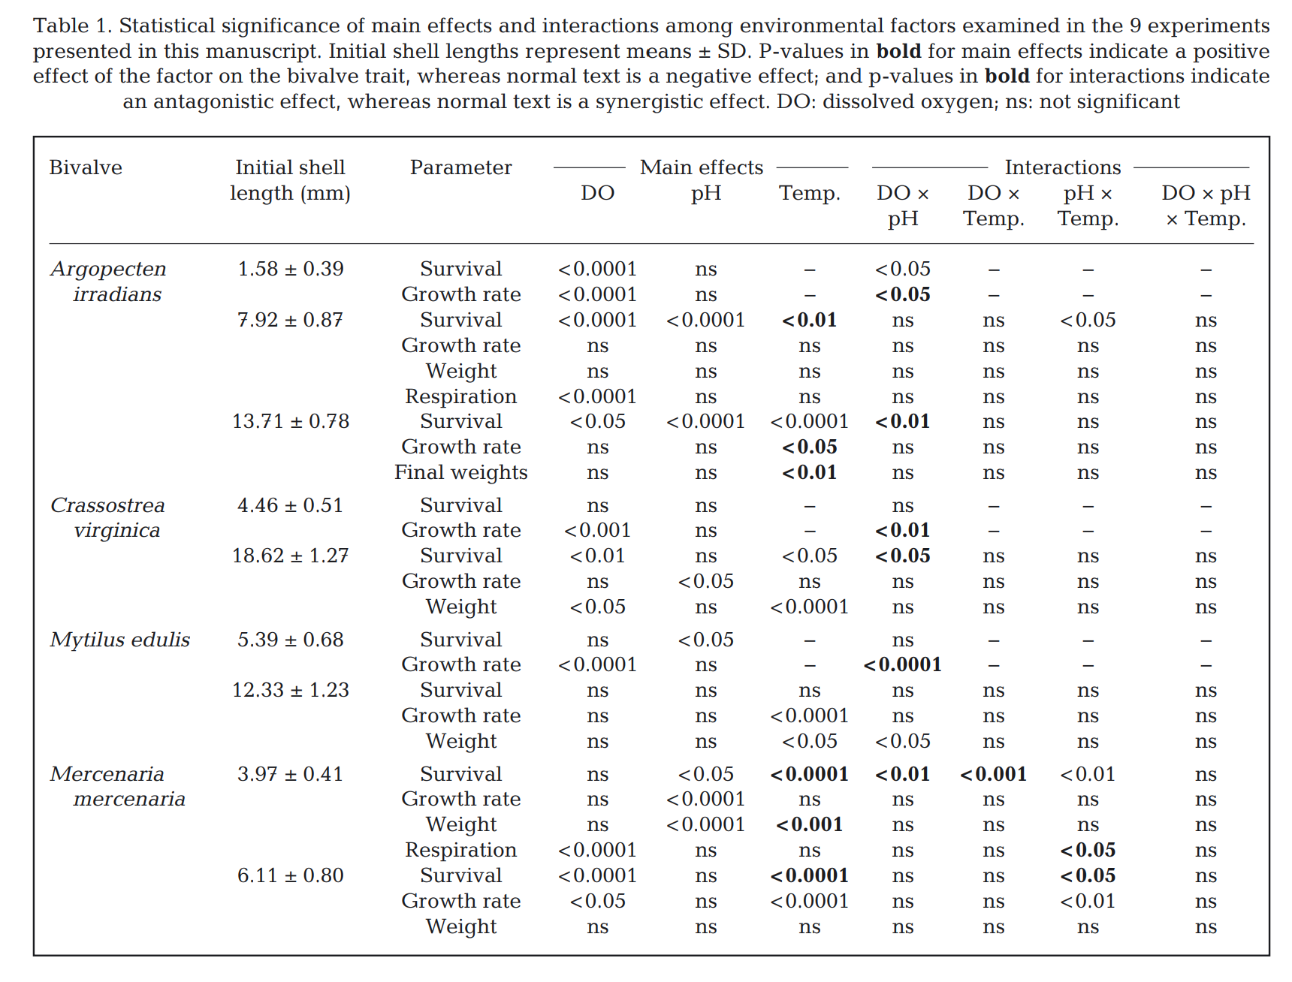
Juvenile oyster (18.62 ± 1.27 mm) survival was marginally but significantly lower in the warmer temperature treatment (31°C) compared to the cooler temperature treatment (24°C)
Low DO (2.26 ± 0.33 mg l−1) also significantly reduced survival rates in juvenile oysters, although this was more pronounced at 31°C compared to 24°C.
neither pH nor DO altered survival rates of juvenile oysters
There was an antagonistic interaction between pH and DO on oyster survival, as when low DO was experienced concurrently with low pH, the negative effects of low DO at 31°C vanished (Table 1, Fig. 5A; Table S15).
Low DO (1.98 ± 0.51 mg l−1) significantly reduced the shell growth of juvenile oysters relative to the control with pH and DO interacting to yield higher shell growth rates than would be expected by the singular treatments
Tissue weights of oysters were reduced in the low DO treatments

Slide 14
To what extent do salinity and total alkalinity impact growth in juvenile Crassotrea virginica oysters?
Figure 1: comparison of average, 5-week growth at ambient [TA] in ambient versus reduced salinity exposure (34 vs 27)
Figure 2: comparison of average, 5-week growth at ambient S (34) across varying [TA] (reduced, ambient, elevated)

Slide 15
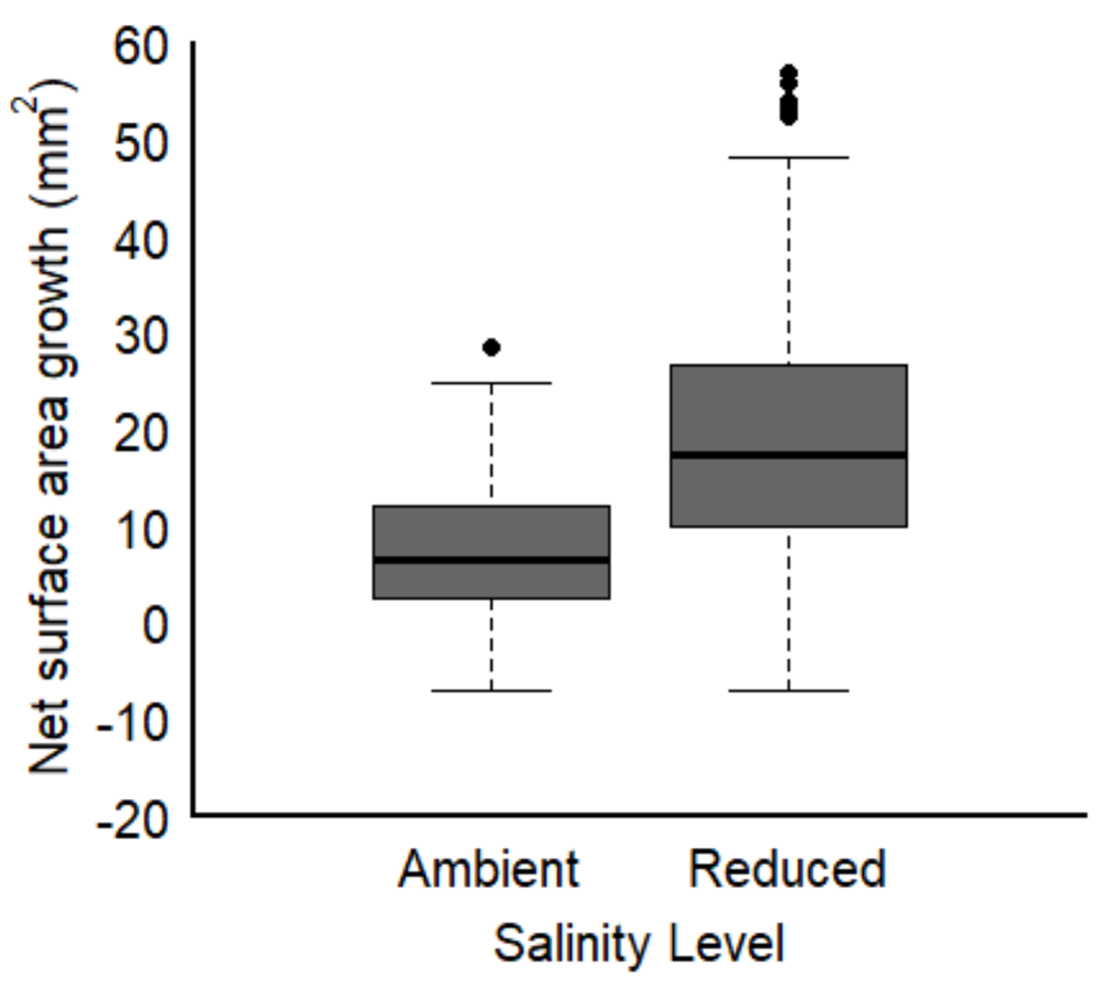
Oysters exposed to reduced salinity conditions had higher net growth rates than those exposed to ambient salinity
Figure 1: comparison of average, 5-week growth at ambient [TA] in ambient versus reduced salinity exposure (34 vs 27)

Slide 16
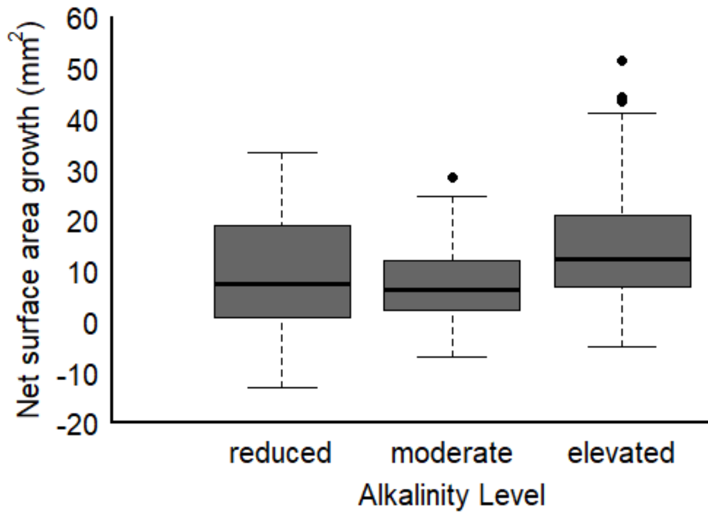
Oysters exposed to elevated alkalinity had higher net growth than those in ambient and reduced alkalinity treatments.
Figure 2: comparison of average, 5-week growth at ambient S (34) across varying [TA] (reduced, ambient, elevated)

Slide 17
To what extent does the total alkalinity of the freshwater source impact growth of juvenile Crassotrea virginica oysters exposed to low salinity conditions?
Figure 3: comparison of average, 5-week growth in conditions when reduced salinity is simulated as: (i) rainfall, (ii) low TA freshwater source, (iii) high TA freshwater source

Slide 18
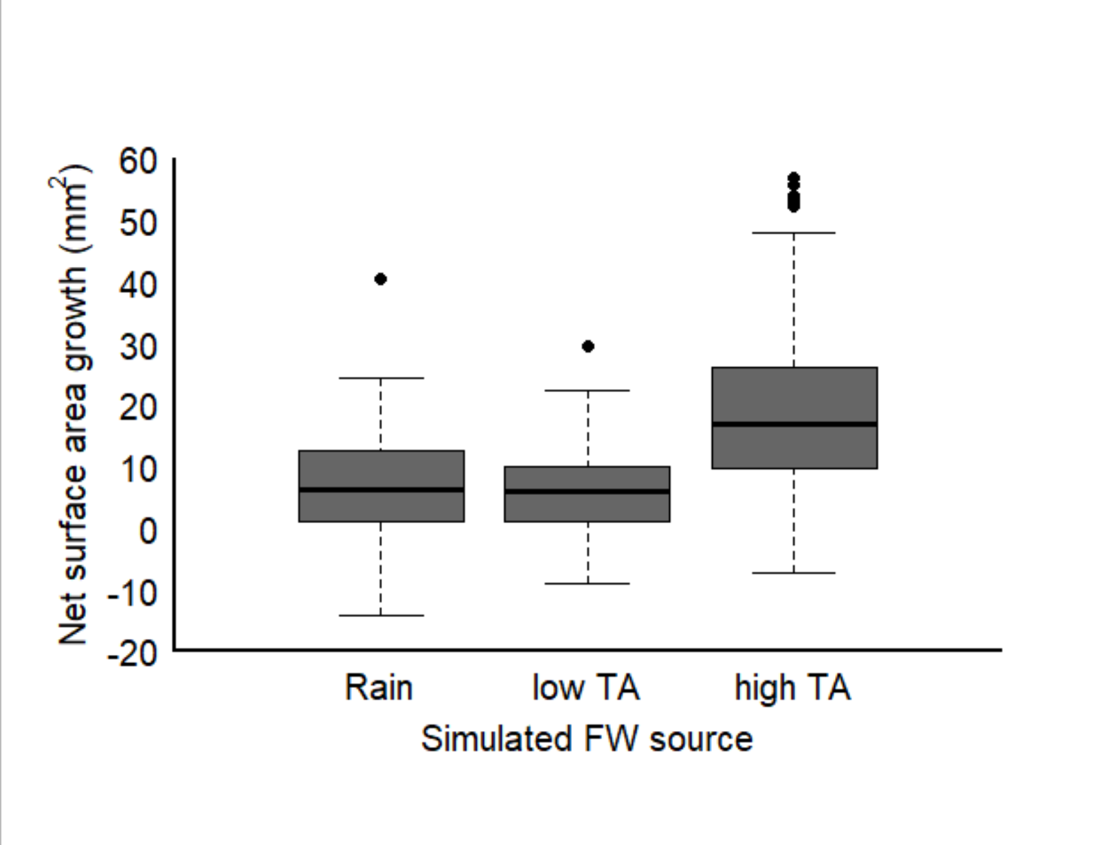
We did not detect a difference in net growth between oysters exposed to treatments diluted with DI and those exposed to conditions imitating exposure to freshwater with low alkalinity signature. However, net growth was higher in conditions simulating exposure to freshwater with elevated alkalinity
Figure 3: comparison of average, 5-week growth in conditions when reduced salinity is simulated as: (i) rainfall, (ii) low TA freshwater source, (iii) high TA freshwater source

Slide 19
Do we detect ‘shock’ growth responses in juvenile Crassotrea virginica oysters?
Figure 4: comparison of incremental growth rates (mm2/day) from the first two weeks of exposure and the last three weeks of exposure along a gradient of [TA] in ambient salinity
Figure 5: comparison of incremental growth rates (mm2/day) from the first two weeks of exposure and the last three weeks of exposure to salinity reduced by three hypothetical scenarios (rainfall, low TA stream, high TA stream)

Slide 20
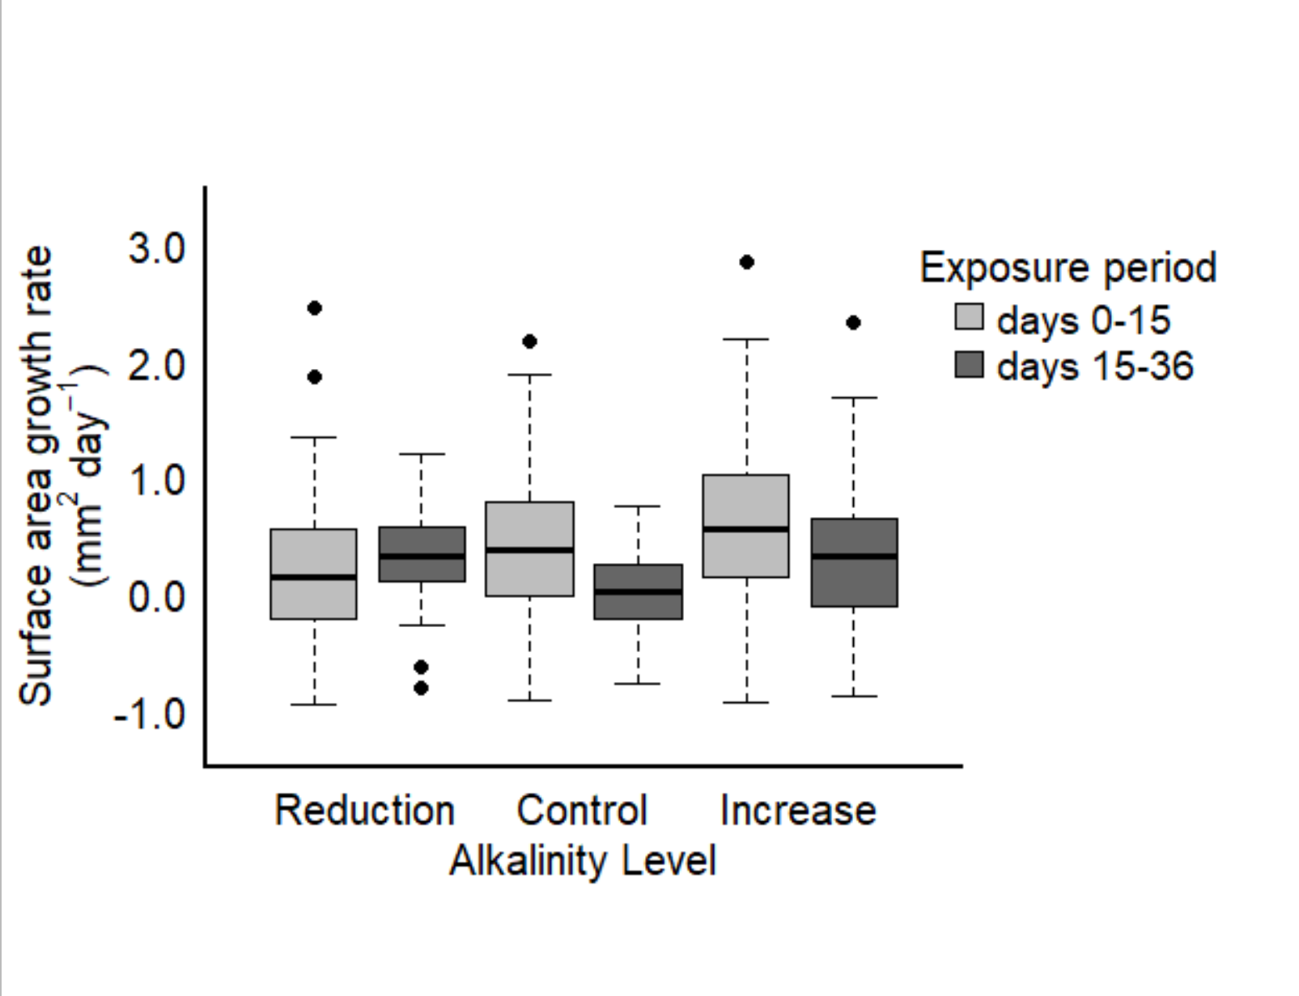
Oyster growth rates had a positive relationship with [TA] over the first two weeks.
Only in treatments with reduced [TA] did we see an increase in incremental growth after two weeks.
Incremental growth slowed down in ambient and elevated TA conditions beyond two weeks of exposure
Figure 4: comparison of incremental growth rates (mm2/day) from the first two weeks of exposure and the last three weeks of exposure along a gradient of [TA] in ambient salinity

Slide 21
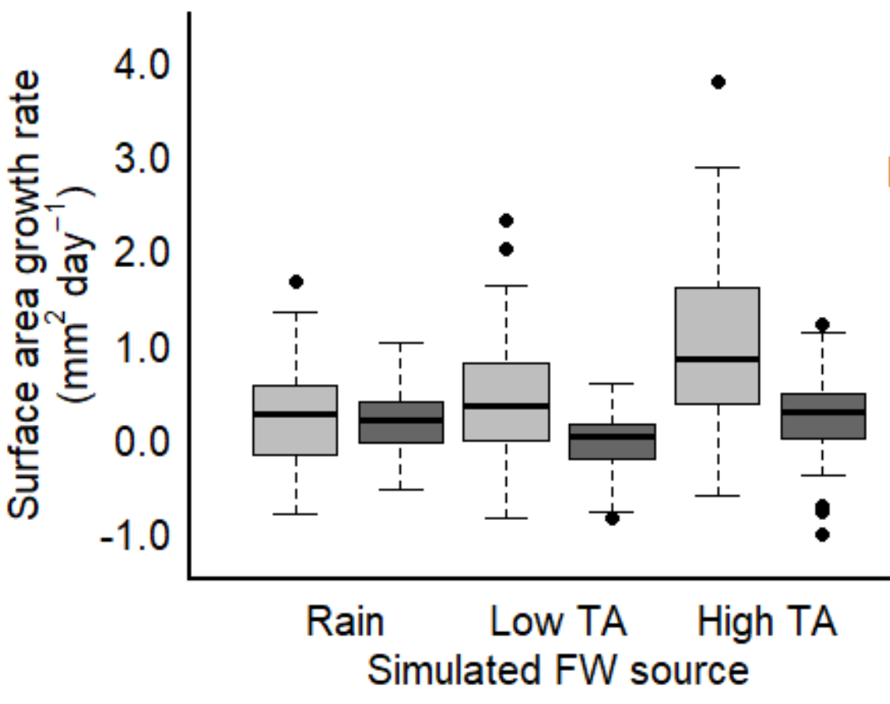
There is a strong effect of high TA on incremental growth rate within the first two weeks.
This effect is persistent, thus, not a ‘shock effect’, however, it does appear to weaken through time
Thus, the added effect of increased alkalinity under low salinity conditions may be most beneficial for immediately upon exposure to low S conditions.
Figure 5: comparison of incremental growth rates (mm2/day) from the first two weeks of exposure and the last three weeks of exposure to salinity reduced by three hypothetical scenarios (rainfall, low TA stream, high TA stream)

Slide 22
To what extent do modified S and TA impact overall C allocation?
Figure 6: comparison of the organic content found in the shell and CI between high and low salinities (at ambient [TA])
Figure 7: comparison of the organic content found in the shell and CI along a gradient of [TA] at ambient salinity
Figure 8: comparison of the organic content found in the shell and CI along a gradient of simulated FW exposure levels

Slide 23
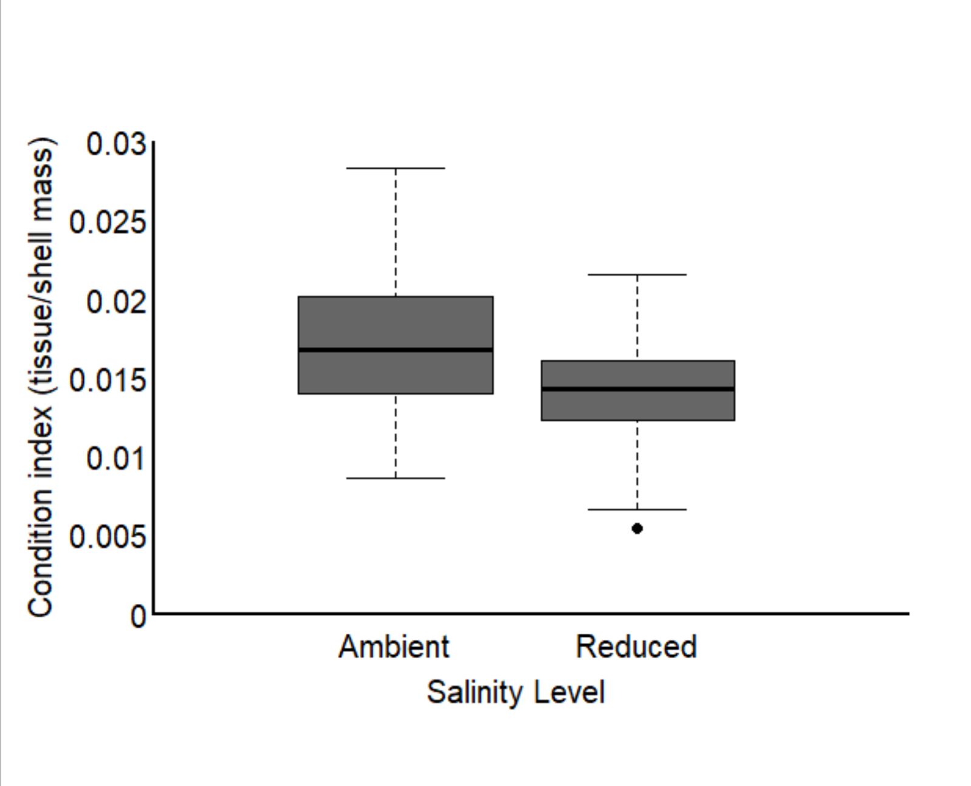
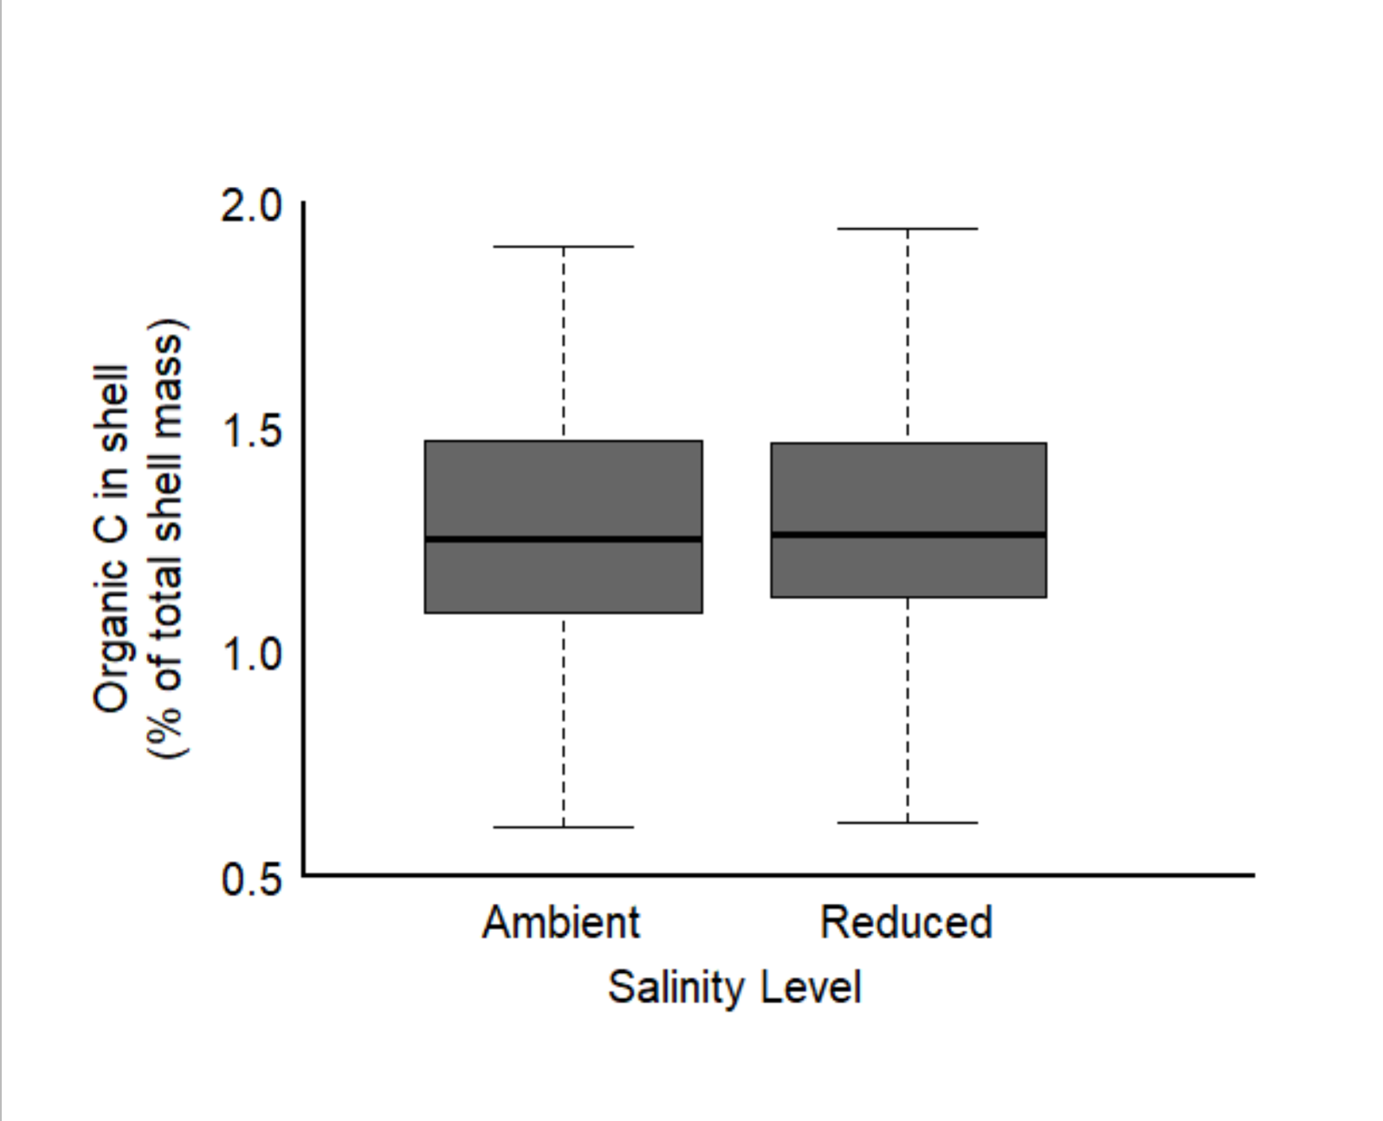
Low salinity did not influence % OC in shell, but did reduce condition index
Figure 6: comparison of the organic content found in the shell and CI between high and low salinities (at ambient [TA])

Slide 24
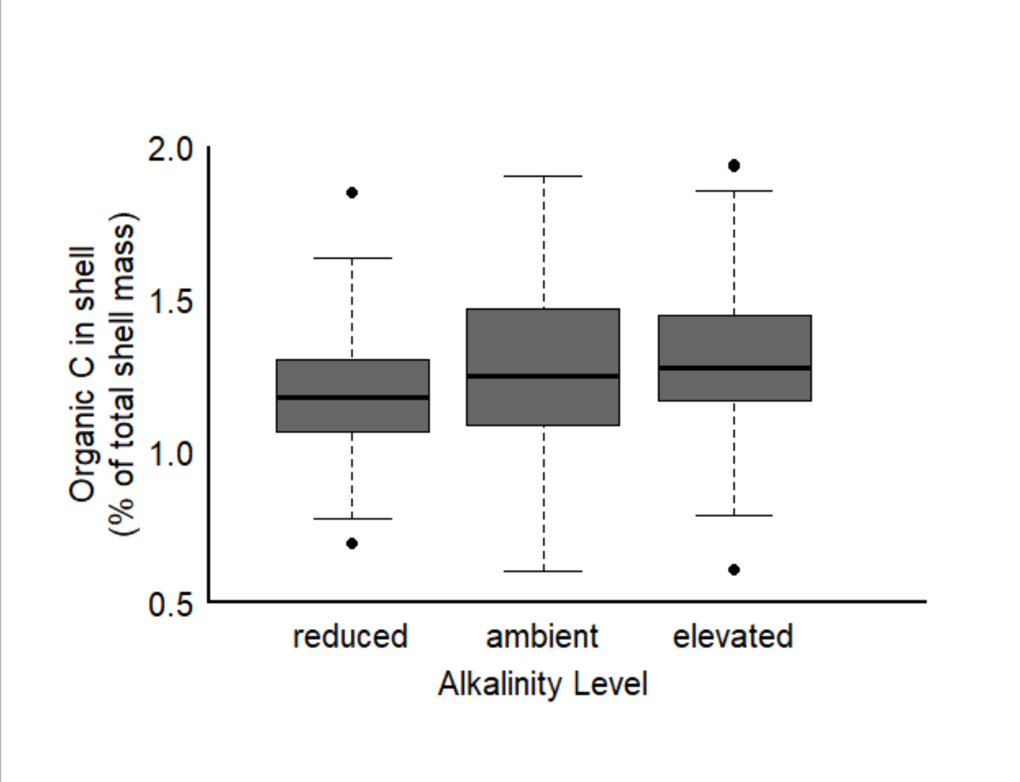
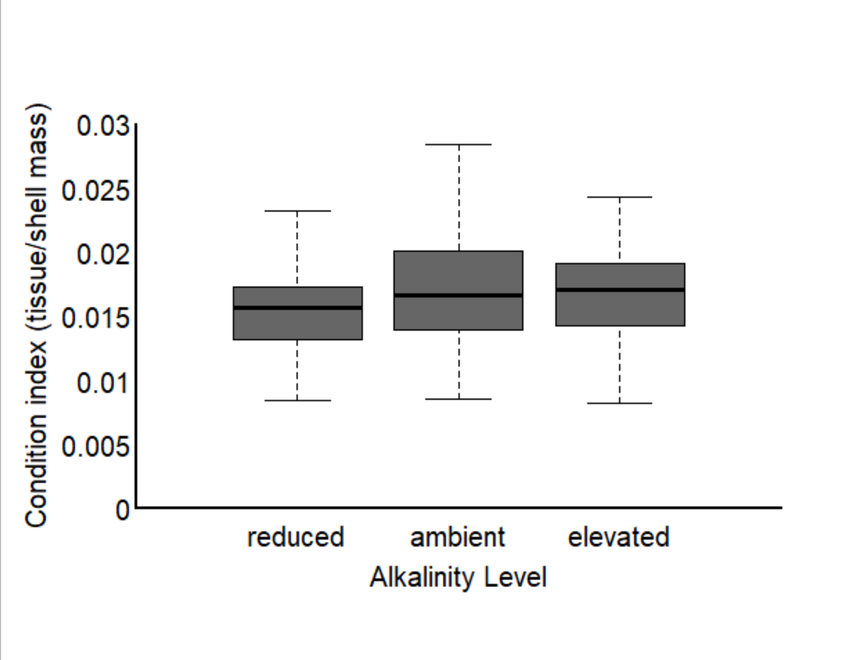
[TA] impacted % OC in shell and condition index similarly
Figure 7: comparison of the organic content found in the shell and CI along a gradient of [TA] at ambient salinity

Slide 25
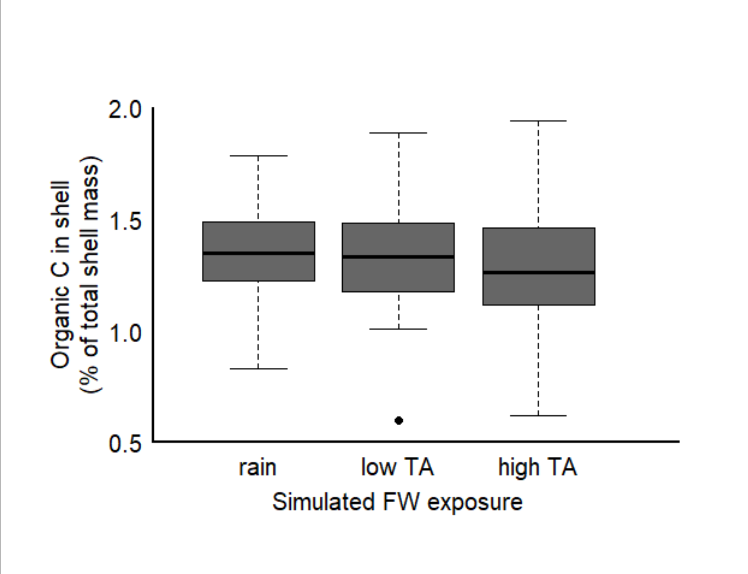
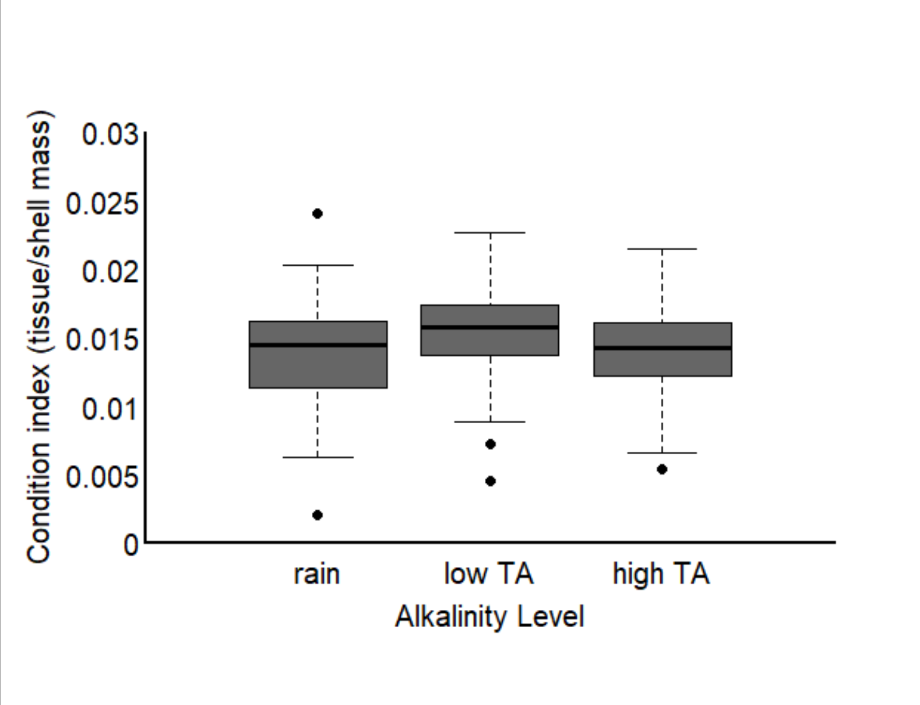
Altered [TA] did not impact %OC in shell, however, condition index was lowest in the rain and high [TA] simulation
Figure 8: comparison of the organic content found in the shell and CI along a gradient of simulated FW exposure levels

Slide 26
What can we say when we put it all together?
Oyster growth was higher in low salinity conditions in amb [TA] (Fig 1)
Oysters also had lower CI values in low salinity conditions; however %OC did not differ (Fig 6)
Oyster growth is elevated by increased total alkalinity above ambient seawater concentrations (Fig 2)
Which was largely driven by high incremental growth in the first two weeks, with incremental growth declining between week 2-5 in the ambient and high TA conditions…(Fig 5)
Ambient and elevated TA had similar CI and %OC in the shell, higher than low TA (Fig 7)
Oyster growth is maintained when alkalinity is severely reduced below ambient conditions (60% reduction) in ambient salinity(Fig 2)
Which was largely driven by an increase in incremental growth after 2 weeks exposure to low TA conditions (Fig 5)
Low TA exposure reduced the %OC and CI of oysters (Fig 7)
Oysters exposed to freshwater inputs that have elevated [TA], have higher growth than those exposed to rainfall/low TA rivers (Fig3)
Which was largely driven by increased incremental growth in the first two weeks, with incremental growth declining between week 2-5…(Fig 5)
We see no difference in %OC in the shell across the freshwater treatments (fig 8)
Individuals from rain exposure and elevated FW TA had lower CI values (Fig 8); this matches the pattern of incremental growth at the later time point (Fig 5)

Slide 27
Let’s also look at variability?

Slide 28
Oysters exposed to reduced salinity conditions had higher variability in growth response
Figure 1: comparison of average, 5-week growth at ambient [TA] in ambient versus reduced salinity exposure (34 vs 27)

Slide 29
Alkalinity concentration did not change the variability in growth.
Figure 2: comparison of average, 5-week growth at ambient S (34) across varying [TA] (reduced, ambient, elevated)

Slide 30
High TA FW exposure had higher variability than in rain and low TA exposure
Figure 3: comparison of average, 5-week growth in conditions when reduced salinity is simulated as: (i) rainfall, (ii) low TA freshwater source, (iii) high TA freshwater source

Slide 31
Variability declined in all treatments through time
Figure 4: comparison of incremental growth rates (mm2/day) from the first two weeks of exposure and the last three weeks of exposure along a gradient of [TA] in ambient salinity

Slide 32
Variability declined in all treatments through time
Figure 5: comparison of incremental growth rates (mm2/day) from the first two weeks of exposure and the last three weeks of exposure to salinity reduced by three hypothetical scenarios (rainfall, low TA stream, high TA stream)

Slide 33
Similar variability
Figure 6: comparison of the organic content found in the shell and CI between high and low salinities (at ambient [TA])

Slide 34
Ambient [TA] showed the highest level of variation
Figure 7: comparison of the organic content found in the shell and CI along a gradient of [TA] at ambient salinity

Slide 35
A large range in Organic C measurements, whereas variation in CI was similar
Figure 8: comparison of the organic content found in the shell and CI along a gradient of simulated FW exposure levels

Slide 36
Ch 3 thoughts…

Slide 37
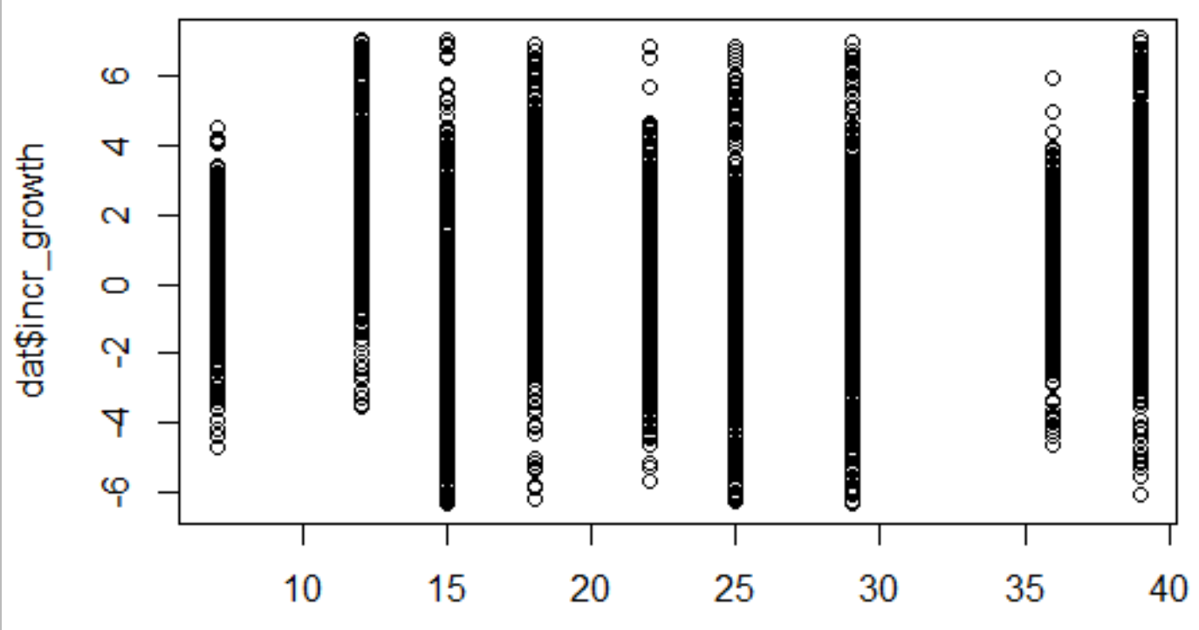
In both salinities, incremental growth cycled

Slide 38
Now just isolate week 1, 2, and the last week

Slide 39
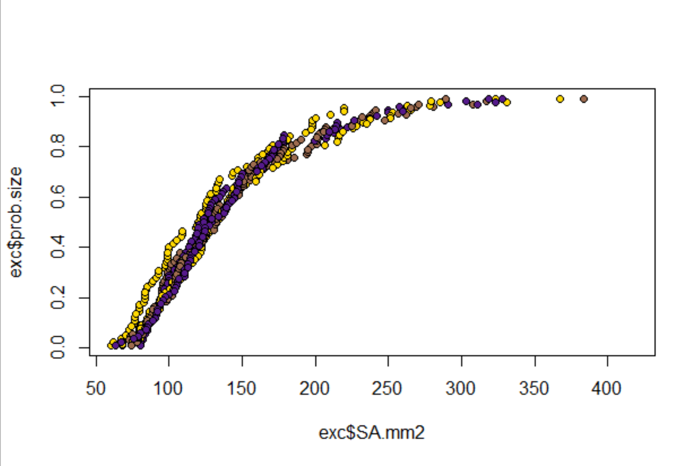
Nice to verify: All the oysters starting surface area rankings and probability of exceedance curves were are similar. Yay!
Low TA
Mod TA
High TA
Probability of exceedance
Starting time point
Surface area of shell (mm2)

Slide 40
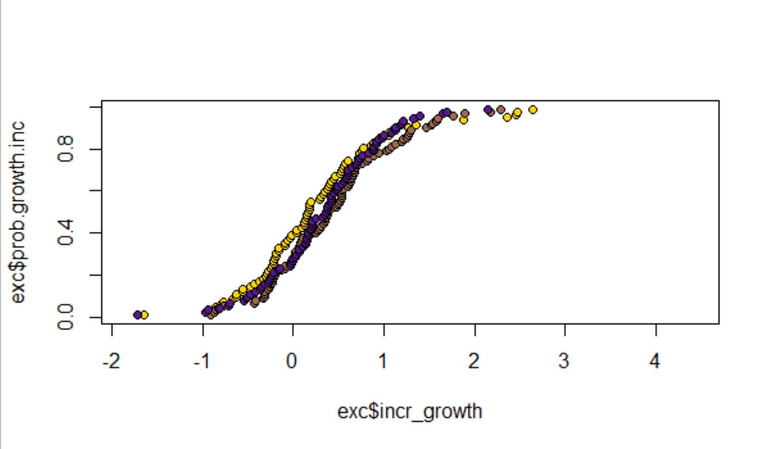
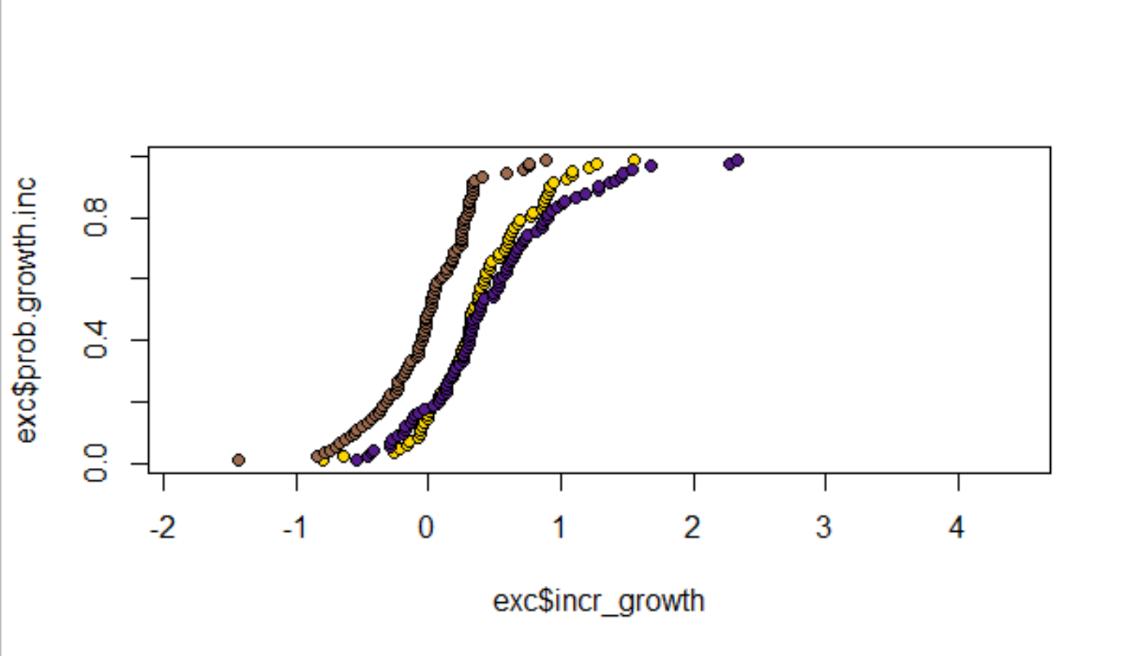
Oysters in ambient salinity: Total alkalinity changes did not influence incremental growth rate (mm2/day calculated between t=0 & t=2 and t=2 & t=5) by week 2 of exposure. Q: How do oysters in ambient salinity maintain incremental growth for the first two weeks of exposure across TA level? Food availability providing a way to upregulate metabolic CO2 pathway for calcification? Between week 2 and week 5, however, it looks like individuals exposed to elevated TA and severely reduced TA had the largest incremental growth rates. Q: reason for severe decline and elevation in TA to result in higher incremental growth rate? What about a moderate TA reduction drives a decrease in incremental growth? Q: what physiologically happens after two weeks that demonstrates a stronger response of TA on incremental growth rate?
Total alkalinity level (umol/kg; % change from ambient)
Low (860; -60%)
Mod (1860; -15%)
High (2840; + 25%)
Week 0-2
Probability of exceedance
Week 2-5
Incremental growth rate (ave mm2/day)

Slide 41
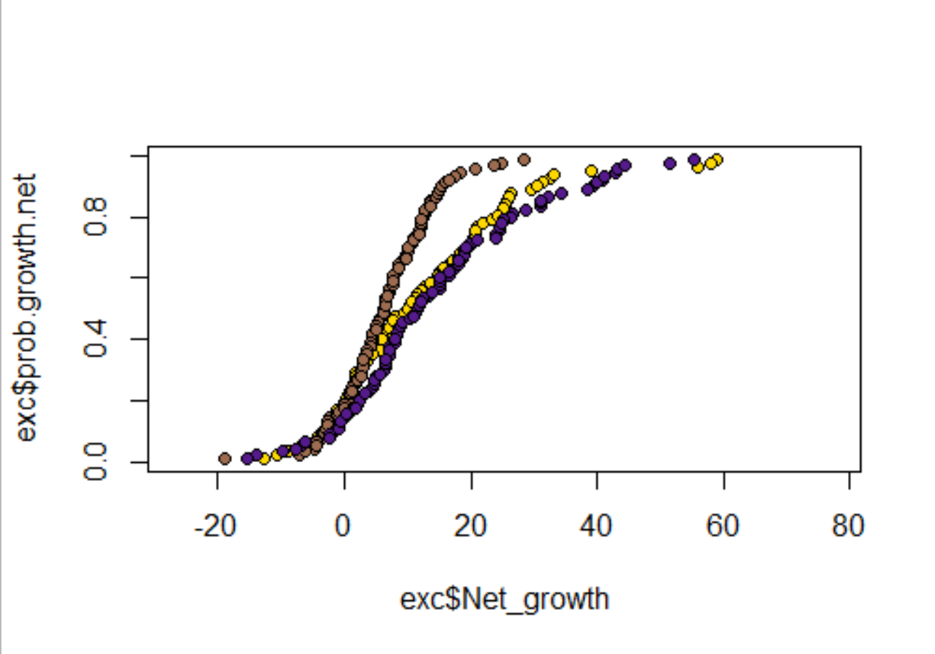
Oysters in ambient salinity: Net growth was elevated in both increased TA and high reduction exposures over 5 weeks, relative to moderate reductions from ambient conditions. It appears that the largest impact on the net effect occurred between week 2 and week 5, where individual incremental growth had a similar pattern to the net growth. This suggests that organismal performance in response to carbonate chemistry changes may not arise until after 14 full days of acclimation to the conditions? However, the elevated growth in low TA conditions is interesting. Do we think that they are upregulating their metabolic inputs from carbonate stress and because they were well fed, were able to compensate for any loss attributed to abiotic conditions. But then what about the modest reduction in TA and its weaker impact on net growth. Is it a reduction in TA that is not enough of a “low shock” to start to upregulate food consumption? Therefor, the reduction may result in an increased proportion of shell that is abiotically eroded and uncompensated for with food?
Total alkalinity level (umol/kg; % change from ambient)
Probability of exceedance
Low (860; -60%)
Mod (1860; -15%)
High (2840; + 25%)
Week 0-5
Net growth (mm2)
Notes:
Things to note: the SA to shell wt relationship did not differ between TA or S trials.

Slide 42
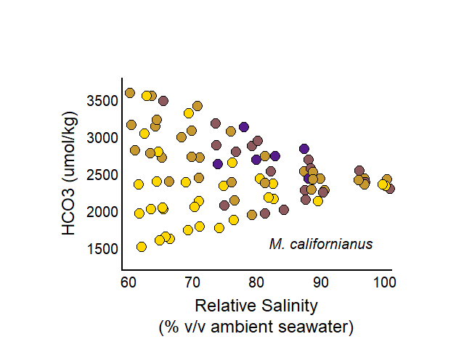
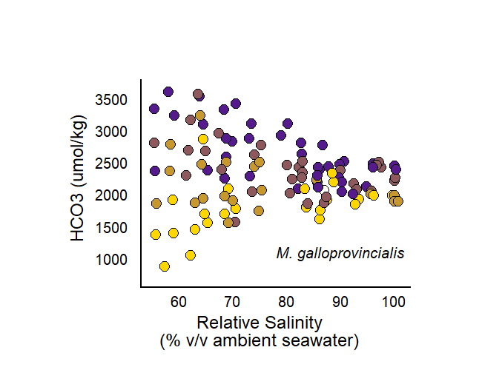
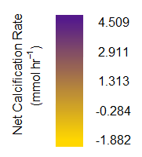
Comparison to ch 2 results for mussels
In mussels…we see that regardless of S, net calc increases with increasing TA… and that effect weakens as you reduce salinity.
However, in oysters, we see that at high S, over the short term (0-2 weeks), that alkalinity did not have an effect on shell growth.
We see the effect of changed alkalinity by the end of the exposure, where it has a bimodal relationship with net growth.

Slide 43
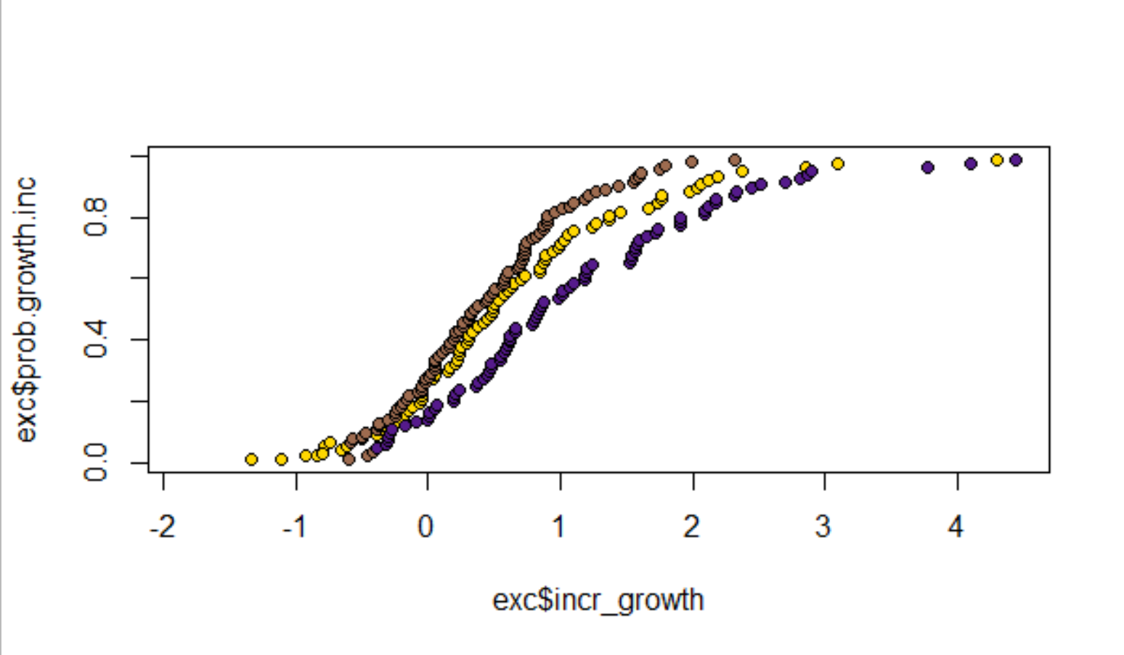
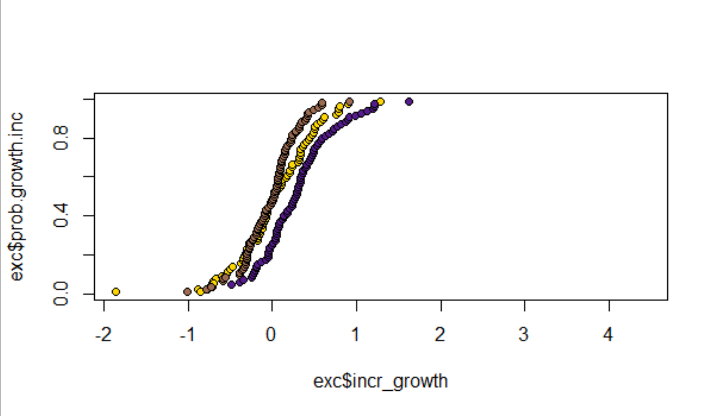
Oysters in low salinity: A reduction in total alkalinity did result in a decrease in incremental growth (mm2/day calculated between t=0 & t=2 and t=2 & t=5) within the first two weeks of exposure. Relative to the highest TA treatment (similar to ambient sw), individuals exposed to an extreme reduction had higher incremental growth than those in moderate reductions of TA. Q: how do individuals make up for the lack of HCO3- present in the seawater more so for the extreme reduction in TA? What about a moderate TA reduction drives a decrease in incremental growth? Between week 2 and week 5, however, it looks like the effect of low TA doesn’t really seem to impact incremental growth rates (it is similar to high TA rates). Q: Why do we see declines in incremental growth rate overall for low salinity exposed individuals after 5 weeks? Are these size related declines (larger individuals grow more slowly?) Q: Why do we tend to only see the effects of low TA on incremental growth rate in the beginning of the exposure?
Week 0-2
Probability of exceedance
Total alkalinity level (umol/kg; % change from ambient)
Low (650; -70%)
Mod (1415; -35%)
High (2130; < -5%)
Week 2-5
Incremental growth rate (ave mm2/day)

Slide 44
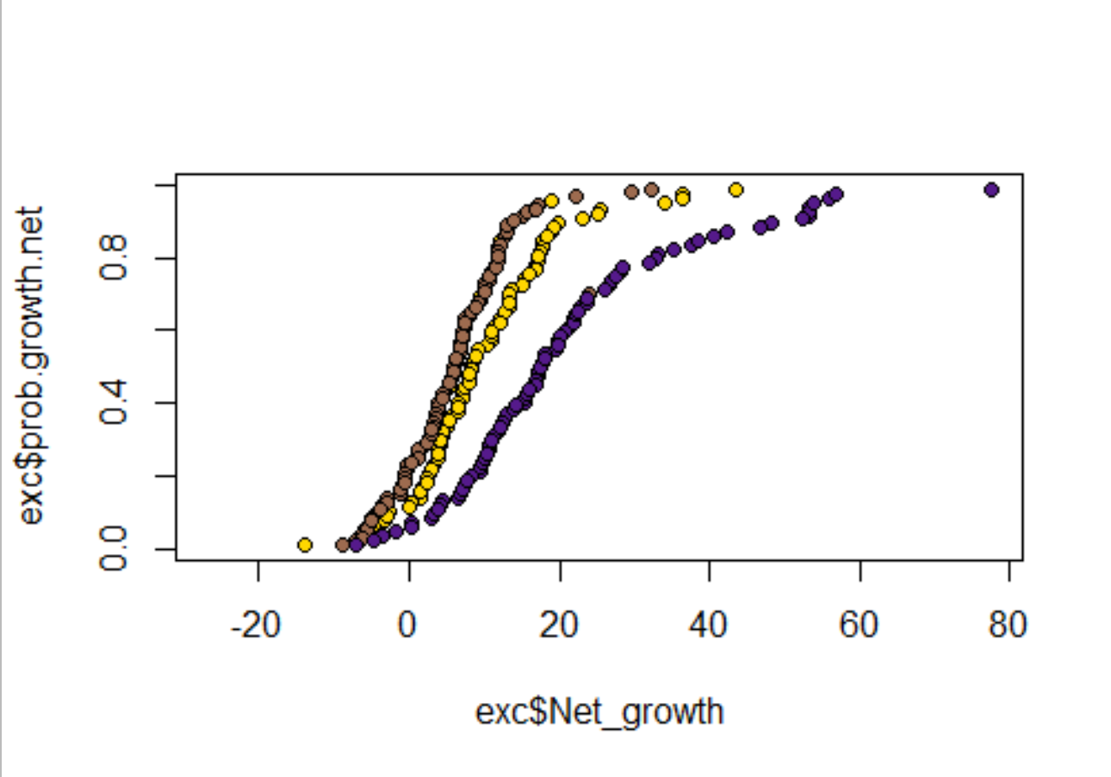
Oysters in low salinity: Net growth was lower in treatments where individuals were exposed to extreme and moderate reductions in TA. It appears that there is a positive relationship with TA, and that potentially both reduction levels were beyond a threshold condition, at which point, individuals are within an equilibrium physiologically with the surrounding corrosive conditions, presenting a similar curve of exceedance. The largest impact on the net effect occurred between week 0 and week 2, where individual incremental growth had a similar pattern to the net growth. This may suggest that organismal performance in response to reductions in TA may become elicited, earlier, with an additional stressor present (simultaneous reduction in S). Further, the effect of S and TA on growth was so strong in the first two weeks, that its effects propagate through to the overall net growth, suggesting that potential rapid pulses of low TA or high TA may propagate into overall net growth rates. Shorter time periods may be a beneficial way to elevate net growth in this case. I think it is also beneficial to note that all of the treatments did have net growth, which may be attributed to a maximal food availability of high protein algal diet.
Total alkalinity level (umol/kg; % change from ambient)
Low (650; -70%)
Probability of exceedance
Mod (1415; -35%)
High (2130; < -5%)
Week 0-5
Week 0-5
Net growth (mm2)

Slide 45
Comparison to ch 2 results for mussels
In mussels…we see that regardless of S, net calc increases with increasing TA… and that effect weakens as you reduce salinity.
In oysters, we see that in LOW S, over the short term (0-2 weeks), that higher TA has a positive effect on shell growth, and that over the entire experiment higher TA resulted in higher net growth.

Slide 46
Comparison thoughts and implications?
Both mussels’ calcification rates responded positively to TA across S
Oysters grown in low S showed a similar relationship, where decreasing TA reduced (both in the short-term incremental growth rate, and net growth)
Their growth declined with declining TA, however, it seems like once past the 35% reduction in TA, they showed similar growth rates in both low TA treatments
Oysters grown in high S instead showed a parabolic response to TA (after 5 weeks of growth), where growth increased in both elevated and severely reduced TA treatments
Initially, individuals did not respond to changes in TA and maintained similar growth rates, however, net growth shows a bimodal increase in growth at increased TA over ambient conc, and in conditions with extremely low TA.

Slide 47
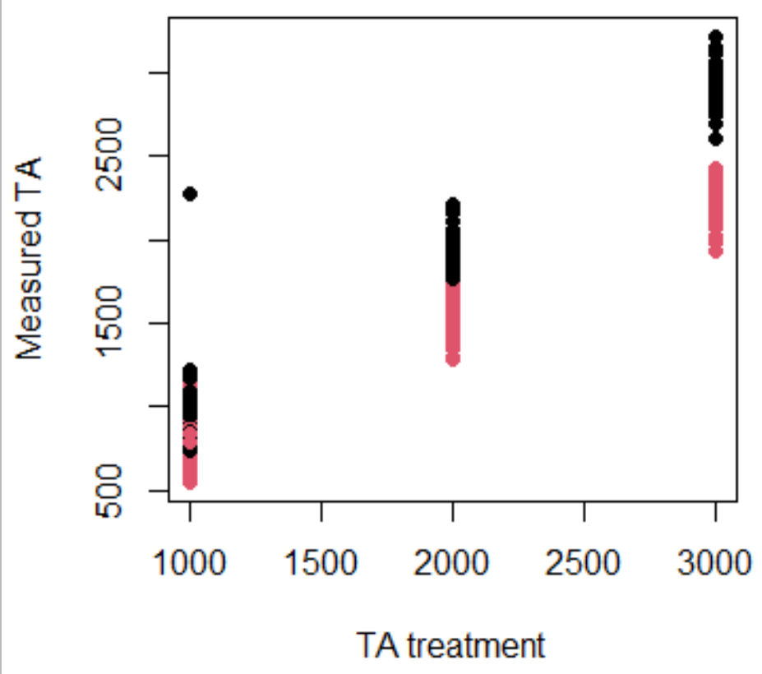
Treatments and sample sizes
Red (low S) and Black (amb S)
Treatments for measured TA vs targets do not necessarily overlap for all bins; if we run the data as a regression does it make more sense to look at each treatment separately?
If we do this, we are not able to compare the effect of S and TA, but are able to demonstrate the effect of TA at both high S and low S
For each of the colors, there are two treatment basins that were used; within each basin, there are between 35-45 individuals (some died/fell off/etc and so have been removed)

Slide 48
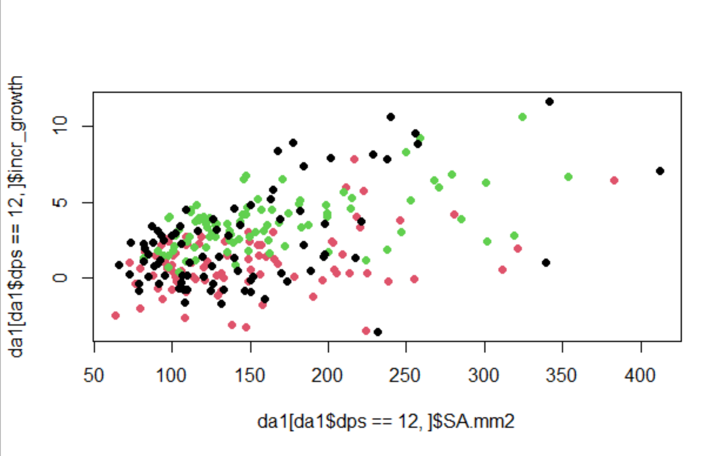
Amb S; 1 - week 2 growth/day
Effect of all drivers.

Slide 49
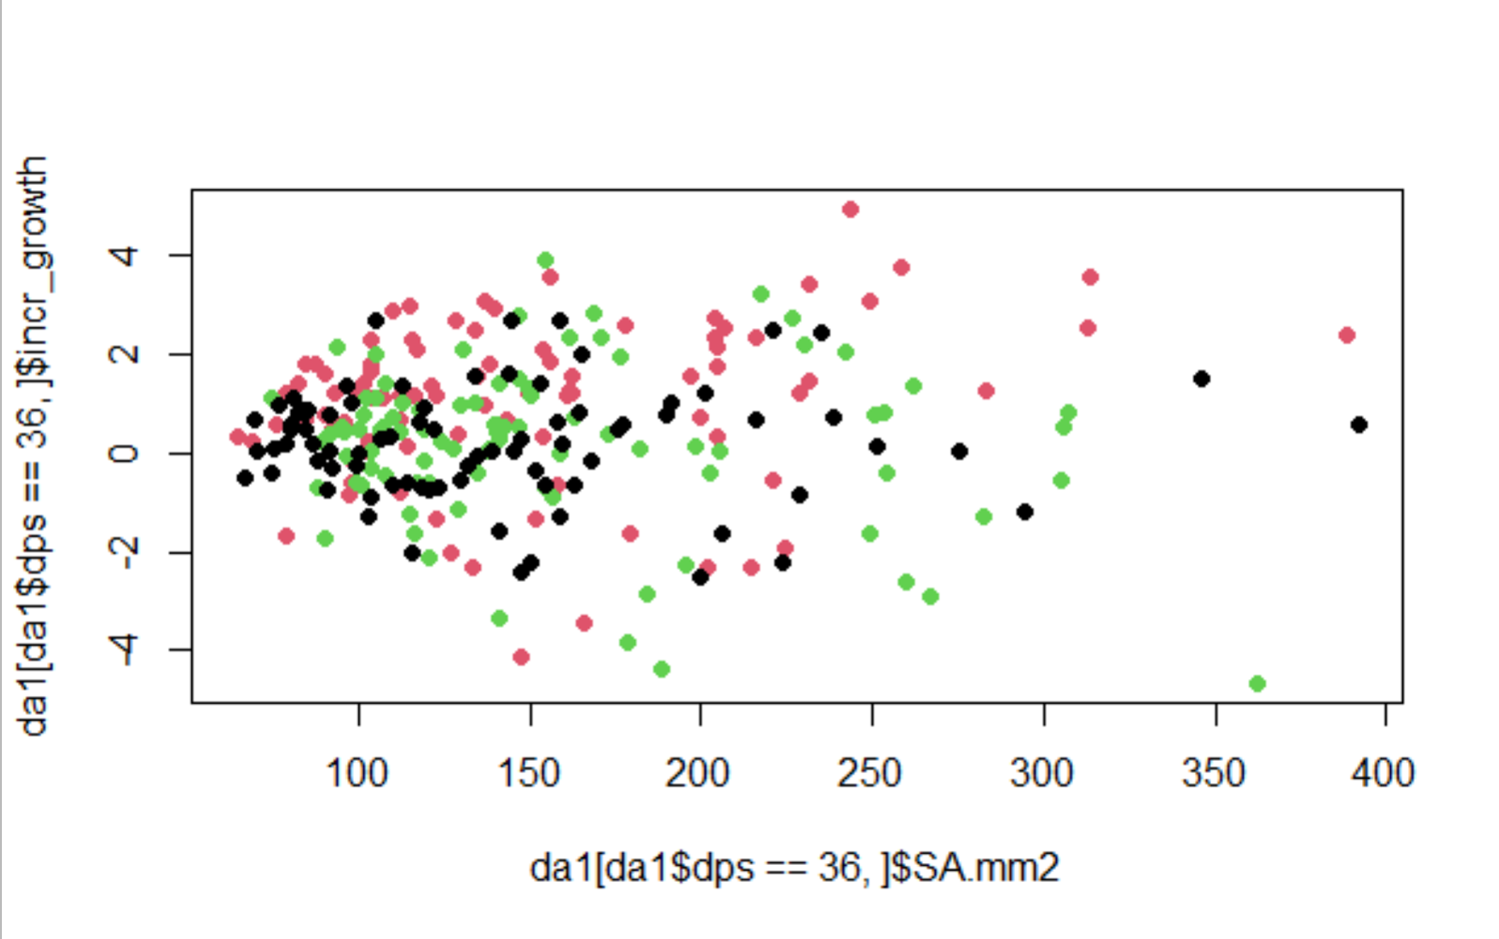
Amb S; 4 - week 5 growth/day
No effect of any drivers.

Slide 50
Amb S; Find the week that the effect disappears
All of the drivers until dps = 36*

Slide 51
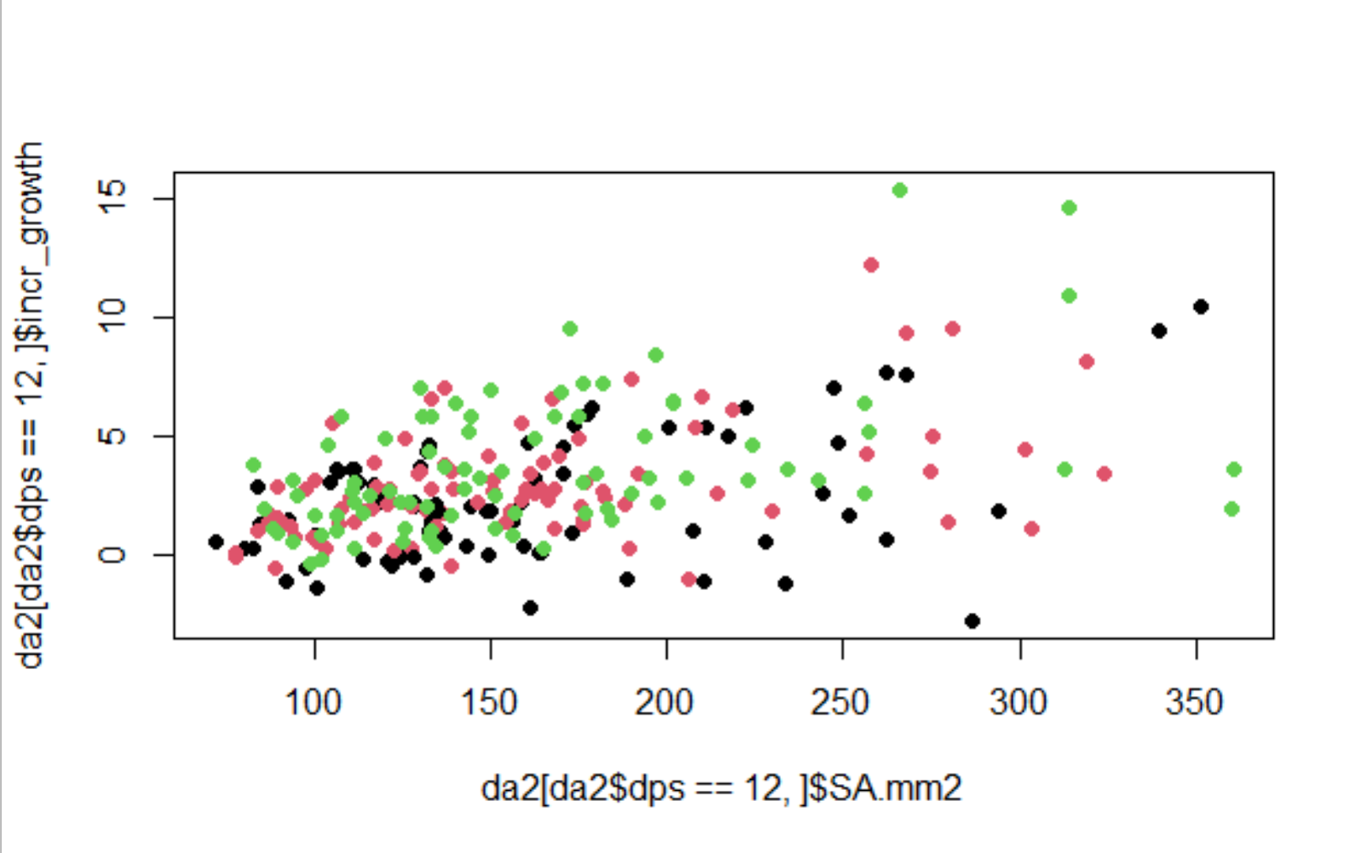
Low S; 1 - week 2 growth/day
Effect of all drivers

Slide 52
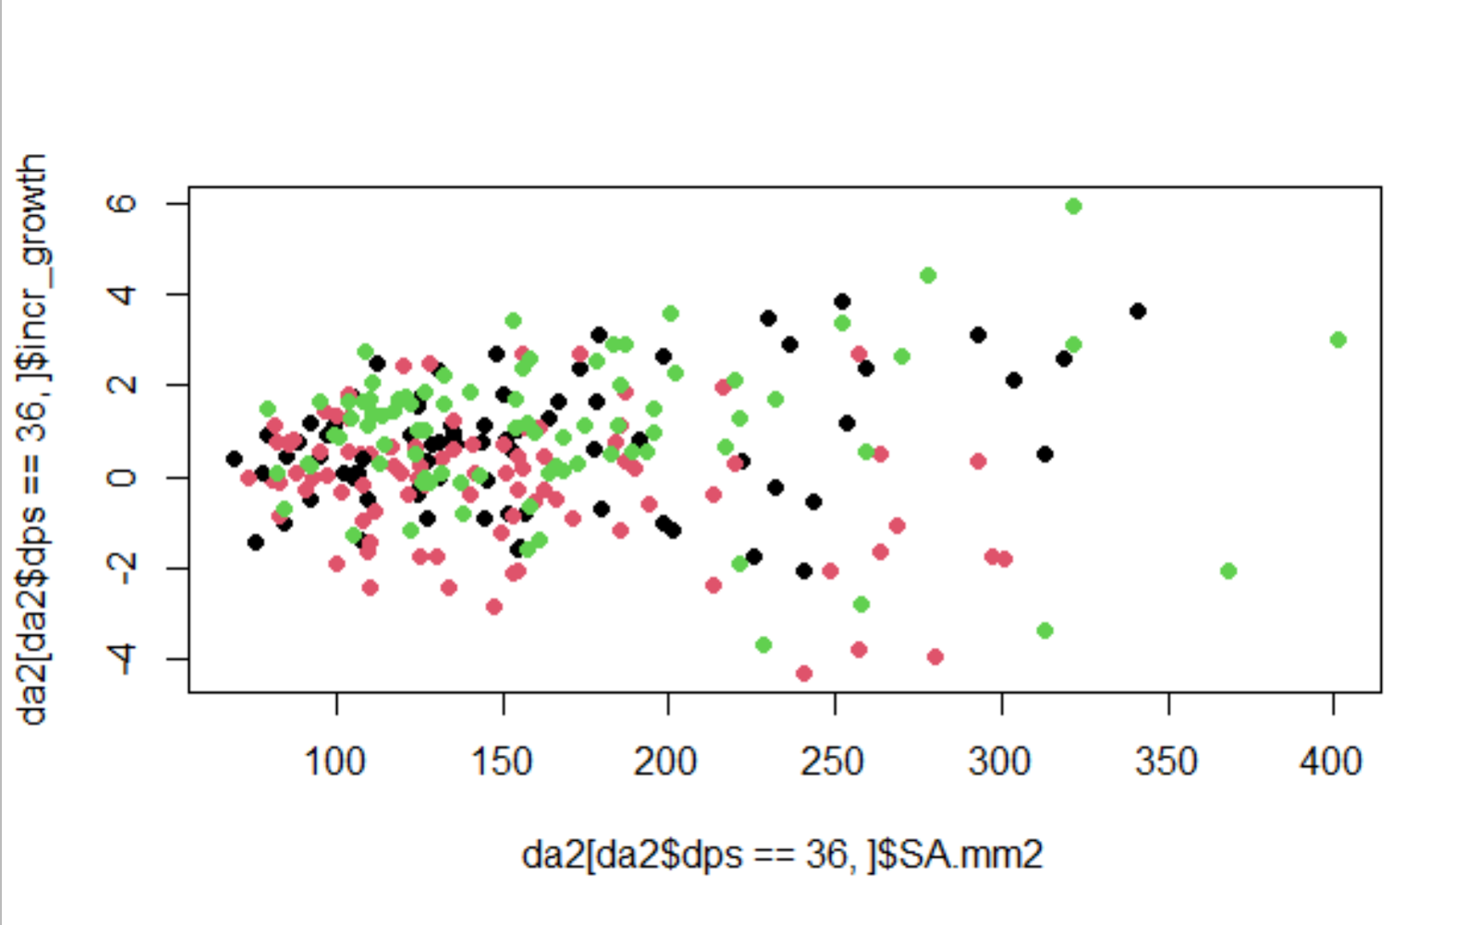
Low S; 4 - week 5 growth/day
No effect of any drivers.

Slide 53
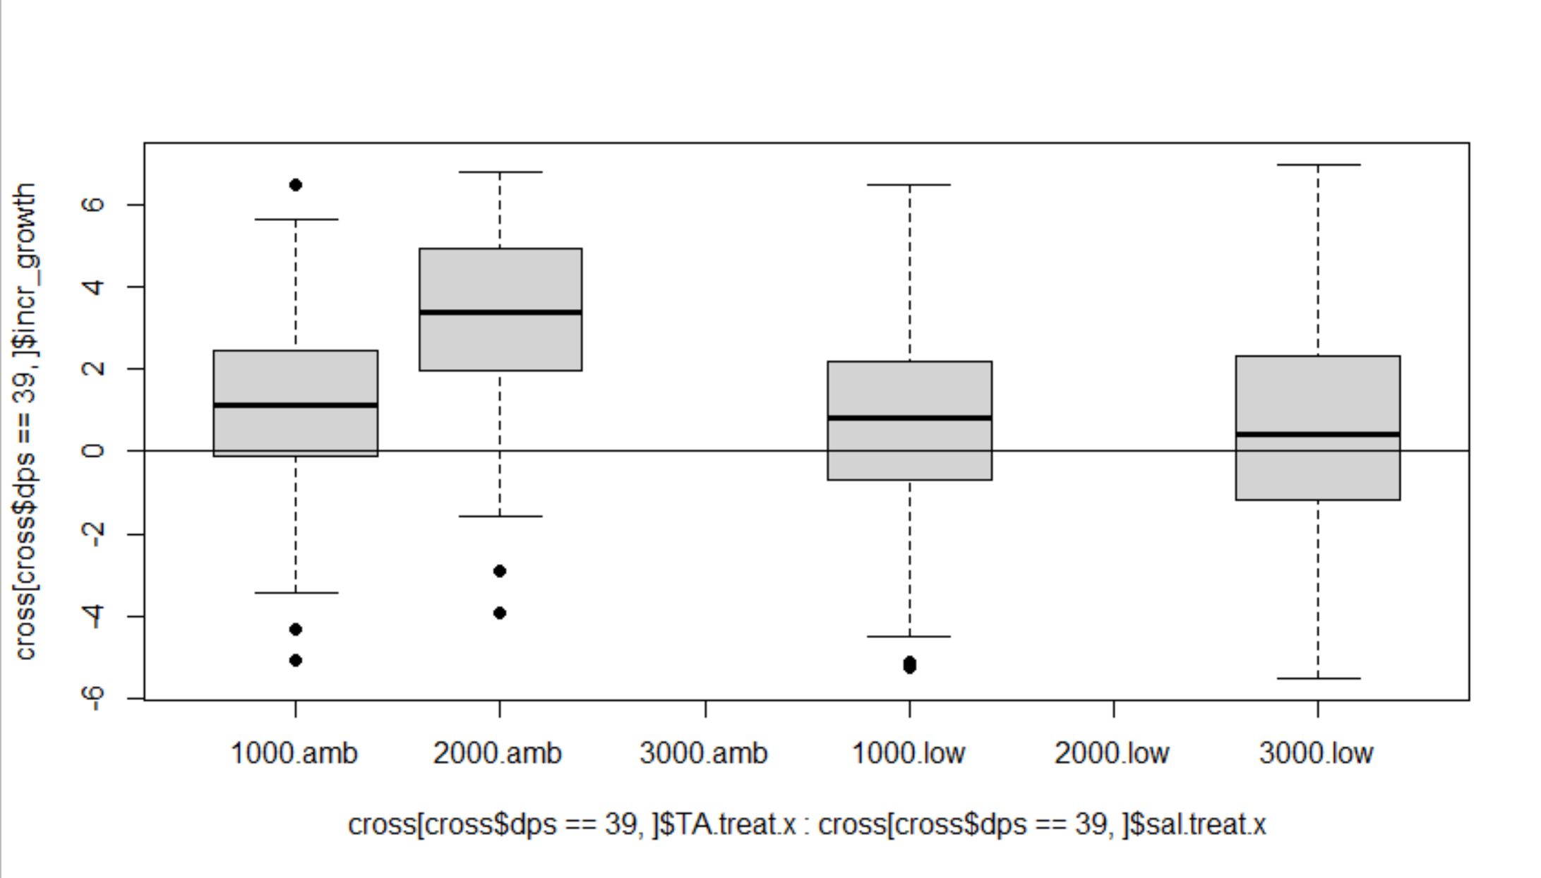
Incremental growth on last day in the cross bins

Slide 54
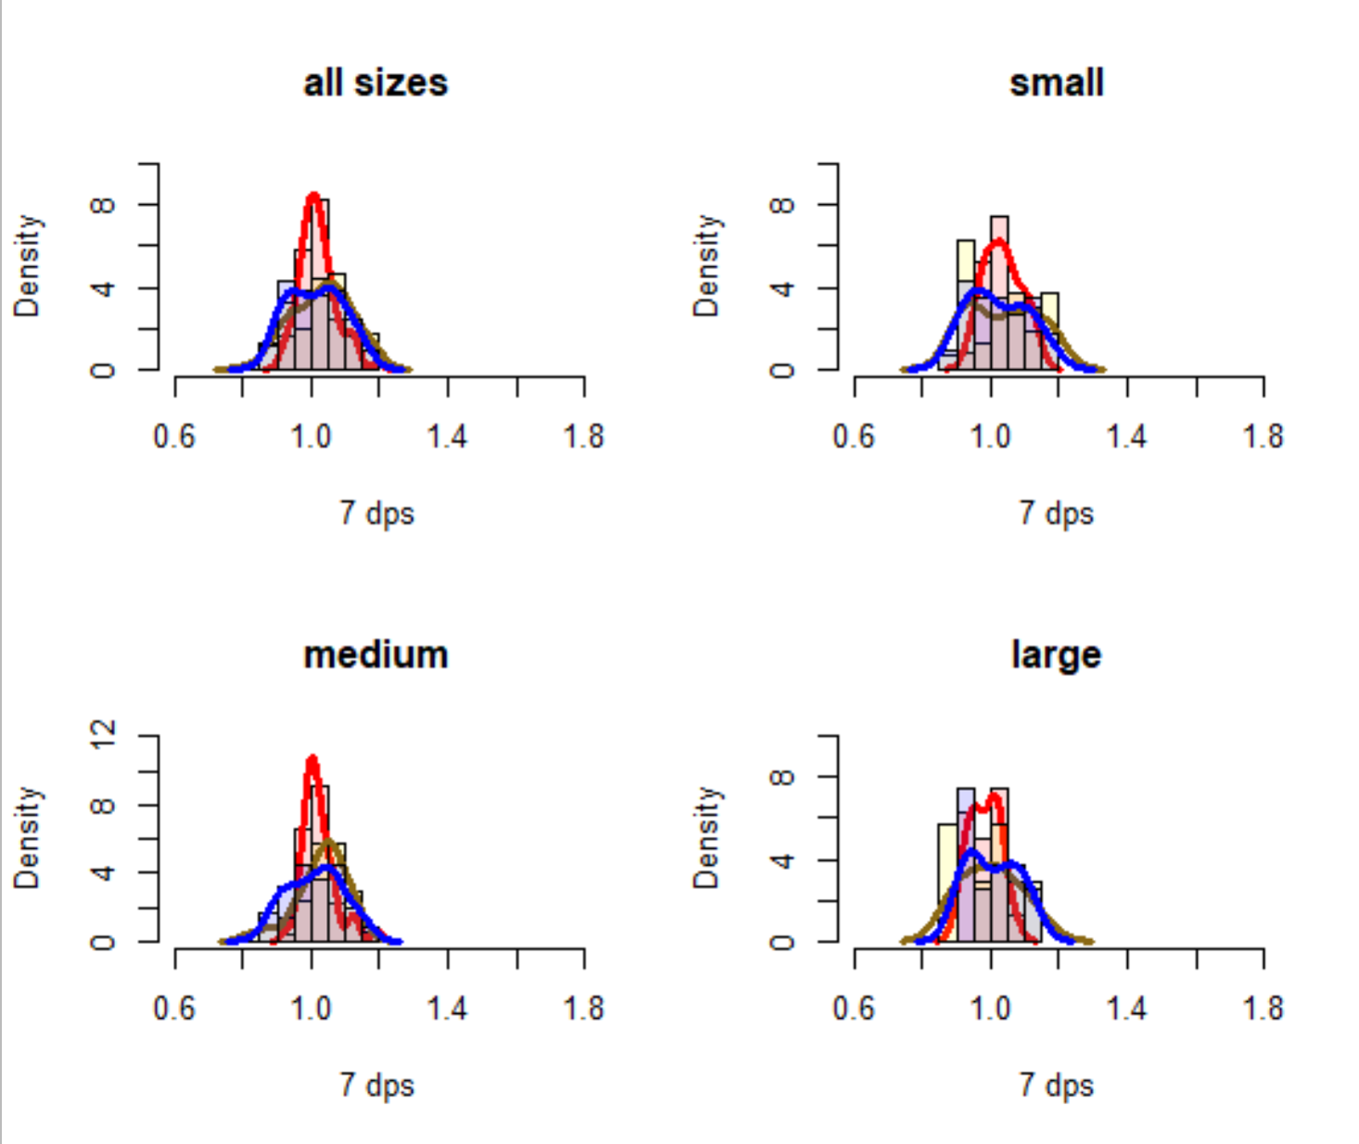
EFFECT OF SIZE AND ALKALINITY ON GROWTH RATIO AFTER 1 WEEK
TA treatment
1000
2000
3000
High salinity

Slide 55

EFFECT OF SIZE AND ALKALINITY ON GROWTH RATIO AFTER 2 WEEKS
TA treatment
1000
2000
3000
High salinity

Slide 56

EFFECT OF SIZE AND ALKALINITY ON GROWTH RATIO AFTER 5 WEEKS
TA treatment
1000
2000
3000
High salinity

Slide 57

EFFECT OF TIME ON GROWTH RATIO (ACCLIMATION DIFFERENCES) WITHIN EACH TREATMENT/SIZE GROUP
TA treatment
1000
2000
3000
1 week
2 weeks
5 weeks
High salinity
Notes:
maybe slightly bigger in last week
Slow and small acclimation

Slide 58

EFFECT OF TIME ON GROWTH RATIO (ACCLIMATION DIFFERENCES) WITHIN EACH TREATMENT/SIZE GROUP
TA treatment
2000
1 week
2 weeks
5 weeks
High salinity
Notes:
Slightly bigger after 2 weeks but no diff to week 3
Fast but minimal acclimation

Slide 59

EFFECT OF TIME ON GROWTH RATIO (ACCLIMATION DIFFERENCES) WITHIN EACH TREATMENT/SIZE GROUP
TA treatment
3000
1 week
2 weeks
5 weeks
High salinity
Notes:
Looks like steady increase in r=growth ratio (but maybe mid time doesn’t differ from either?
Slow acclimation; second biggest shifts in growth

Slide 60

EFFECT OF SIZE AND ALKALINITY ON GROWTH RATIO AFTER 1 WEEK
TA treatment
1000
2000
3000
Low salinity

Slide 61

EFFECT OF SIZE AND ALKALINITY ON GROWTH RATIO AFTER 2 WEEKS
TA treatment
1000
2000
3000
Low salinity

Slide 62

EFFECT OF SIZE AND ALKALINITY ON GROWTH RATIO AFTER 5 WEEKS
TA treatment
1000
2000
3000
Low salinity

Slide 63

EFFECT OF TIME ON GROWTH RATIO (ACCLIMATION DIFFERENCES) WITHIN EACH TREATMENT/SIZE GROUP
TA treatment
1000
2000
3000
1 week
2 weeks
5 weeks
Low salinity
Notes:
Possible shift to the right on the last week?
Slow acclimation; very small shift

Slide 64

EFFECT OF TIME ON GROWTH RATIO (ACCLIMATION DIFFERENCES) WITHIN EACH TREATMENT/SIZE GROUP
TA treatment
2000
1 week
2 weeks
5 weeks
Low salinity
Notes:
Possible shift to the rig
Fast acclimation (but small)
ht on week 2 but then no difference in week 5 from 2

Slide 65

EFFECT OF TIME ON GROWTH RATIO (ACCLIMATION DIFFERENCES) WITHIN EACH TREATMENT/SIZE GROUP
TA treatment
3000
1 week
2 weeks
5 weeks
Low salinity
Notes:
Larger growth rate shift from week 1 to week 2 than in other treatments, almost no change from week 2 to week 5
Fast acclimation

Slide 66
Acclimation Speeds + amounts by treatment
 | Acclimation speed
Degree of growth change? | Fast (change from week 1 to 2, and then no change from week 2 to week 5) | Slow (change from week 1 to 2 and from 2 to 5)
Large shift in average growth ratio | Low S, High TA | High S, High TA
Minimal shift in average growth ratio | High S, Moderate TA Low S, Moderate TA | High S, Low TA Low S, Low TA

Slide 67
Acclimation speed
Big,
slow
Big,
fast
Inc. [TA]
Inc. Salinity
Degree of change
Small, slow
Small, fast

Slide 68
















Arrange tiles from white → brown

Slide 69

Color change is related to pH and TA, but not S
6
5
10
9
3
1
Median Total Alkalinity
4
8
12
11
2
7
Low ----------------------------------------> High
relative pH (across a 0.25 unit change)
Notes:
Bottom left: 2 and 7
Bottom middle: 11 (right) and 12 (left)
Middle middle: 4 (left) and 8 (same pH as 10; right)
Middle right: 1 (left) and 3 (right)
Middle top: 9 (right) and 10 (left; same pH as 4 and 8)
Top right: 5 (right) and 6 (left)

Slide 70
Color change is related to pH and TA, but not S
increasing pH improves coloration
increasing TA improves coloration
Median Total Alkalinity
Low ----------------------------------------> High
relative pH (across a 0.25 unit change)

Slide 71
Color change is related to pH and TA, but not S
increasing pH improves coloration
increasing TA improves coloration
Median Total Alkalinity
Low ----------------------------------------> High
relative pH (across a 0.25 unit change)

Slide 72
Color change is related to pH and TA, but not S
increasing pH improves coloration
increasing TA improves coloration
Median Total Alkalinity
Low ----------------------------------------> High
relative pH (across a 0.25 unit change)

Slide 73

Do we see patterns related to organic content?
ab
d
d
ab
d
ab
1 2 3 4 5 6 7 8 9 10 11 12 "ab" "c" "b" "d" "d" "d" "d" "ad" "ab" "ab" "bc" "e"
c
ad
b
d
bc
e

Slide 74

Assigning each group a ‘saturation’ icon
d
ad
e
ab
c
ab
ab
d
d
bc
b
d

Slide 75
Color change is related to pH and TA, but not S
d
d
ab
ab
b
ab
Median Total Alkalinity
ad
d
d
c
bc
e
Low ----------------------------------------> High
relative pH (across a 0.25 unit change)

Slide 76
Color change is related to pH and TA, but not S
d
d
ab
No apparent trend in similarity between the color change and the % organic material
Only comprising between 1-2% of the shell and so may be difficult to see differences in such small changes (based on just perio being removed)
ab
b
Higher % OC
ab
Median Total Alkalinity
ad
d
d
c
bc
e
Low ----------------------------------------> High
relative pH (across a 0.25 unit change)

Slide 77
Color change is related to pH and TA, but not S
d
d
ab
No apparent trend in similarity between the color change and the % organic material
Only comprising between 1-2% of the shell and so may be difficult to see differences in such small changes (based on just perio being removed)
Middle % OC
ab
b
ab
Median Total Alkalinity
ad
d
d
c
bc
e
Low ----------------------------------------> High
relative pH (across a 0.25 unit change)

Slide 78
Color change is related to pH and TA, but not S
d
d
ab
No apparent trend in similarity between the color change and the % organic material
Only comprising between 1-2% of the shell and so may be difficult to see differences in such small changes (based on just perio being removed)
ab
b
ab
Median Total Alkalinity
Low % OC
ad
d
d
c
bc
e
Low ----------------------------------------> High
relative pH (across a 0.25 unit change)

Slide 79
Color change is related to pH and TA, but not S
d
d
ab
No apparent trend in similarity between the color change and the % organic material
Only comprising between 1-2% of the shell and so may be difficult to see differences in such small changes (based on just perio being removed)
Middle % OC
ab
b
Higher % OC
ab
Median Total Alkalinity
Low % OC
ad
d
d
c
bc
e
Low ----------------------------------------> High
relative pH (across a 0.25 unit change)

Slide 80



Shell wt. and SA have very tight relationship; no apparent grouping by TA or S… shell composition is similar

Slide 81

Relationship between size and organic content.. Did not change among different size classes
Larger SA had higher prop of shell as OC matter, makes sense with surface area driven growth
Also suggests that TA nor S strongly dictated the prevalence of a substantial organic layer on shells

Slide 82
Suggesting… the color of the shell, although driven by the presence of periostracum, must also gain color via bacteria/diatom growth
color loss implications for:
1. albedo effect/temperature in low tide?
2. biological layer (vs. organic) between seawater
i. change interaction with biochemical reactions in benthos

Slide 83


Increased TA results in higher SA growth; however, growth rates were higher in low S (not pictured)

Slide 84

Lower condition index resulted in higher OC found in the shell; increasing TA amplified OC at a given CI
Trade off between CI vs OC
“storage” of reserves vs. “shield”?
Higher TA allows for individuals to create more resistant shells?

Slide 85

No relationship between growth and the amount of OC found in the shell
Overall growth didn’t relate to shell composition…so the surface area of the individual wasn’t related to the composition

Slide 86

Shell mass to SA relationship was not impacted by TA or S by the last day of acclimation
Consistent with expectations
Maybe because shells were still small and OC proportion was low relative to the rest of the mass?

Slide 87

Colors by treatment: red = mid TA green = low TA blue = high TA size: ALL

Slide 88

Colors by treatment: red = mid TA green = low TA blue = high TA size: SMALL

Slide 89

Colors by treatment: red = mid TA green = low TA blue = high TA size: MEDIUM

Slide 90

Colors by treatment: red = mid TA green = low TA blue = high TA size: LARGE

Slide 91

Colors by treatment: red = amb S
Green = low S size: all sizes

Slide 92

Colors by treatment: red = amb S
Green = low S size: SMALL

Slide 93

Colors by treatment: red = amb S
Green = low S size: MEDIUM

Slide 94

Colors by treatment: red = amb S
Green = low S size: LARGE

Slide 95

Only high S data, all sizes pooled Colors by treatment: red = mid TA green = low TA blue = high TA

Slide 96

Only low S data, all sizes pooled Colors by treatment: red = mid TA green = low TA blue = high TA

Slide 97


High Salinity
36 days (dark)
15 days (light)
Low Salinity

Slide 98



High Salinity
36 days (dark)
15 days (light)
Low Salinity
3000
2000
1000
3000
2000
1000
3000
2000
1000

Slide 99


36 days (dark)
15 days (light)
High Salinity
Low Salinity
3000
2000
1000

